Slide 1
CHA Intake Agent Meeting
March 2026

Slide 2
Today’s Agenda:
Introductions / Roll Call
Jurisdiction Areas # of participants
Contact Updates
CHA website tab for Intake Agent resources
Inspection Reminders
Other Questions ???

Slide 3

Introductions:
Sherrie
In
Gillette & Wright
Michelle in Sheridan
AJ in
Buffalo
Susan in Cody &
Powell
Angela in Riverton & Lander
Mike & Luis & Lisa in Rawlins
Kaylee in Laramie
Al in Cheyenne
This Photo by Unknown Author is licensed under CC BY-SA

Slide 4
Jurisdiction Areas # of participants:
Cheyenne / Laramie County = 987
Laramie = 181
Buffalo = 17
Cody / Powell = 70
Gillette/ Wright = 244
Lander / Riverton =71
Rawlins = 16
Sheridan = 179
CHA has 1806 HUD assigned (no jurisdiction specific) = we are fully utilized!
We also have 158 VASH vouchers = 75ish% utilized
(Cheyenne, Laramie, Sheridan, Gillette and Riverton)

Slide 5
CHA Contact information:
The case managers in Section 8 current tenant Vouchers are assigned by the tenant’s last name
(aka annual or special inspections):
  A – G: Jemini Hernandez; jhernandez@cheyennehousing.org; 307-633-8301
  H – 0: Wendy Renteria; wrenteria@cheyennehousing.org; 307-633-8322
  P – Z: Nicole Stock; nstock@cheyennehousing.org; 307-633-8336
  Please note all annual inspection results should be emailed to Amanda.
The Eligibility team works with applicants throughout the process of receiving a Section 8 Voucher:
  eligibility@cheyennehousing.org
Housing Programs Director / HCV QC Inspector: Amanda Allard; 307-633-8314; aallard@cheyennehousing.org
Cheyenne HCV Inspector / NSPIRE expert: Al Dubois; 307-630-1553; adubois@cheyennehousing.org

Slide 6
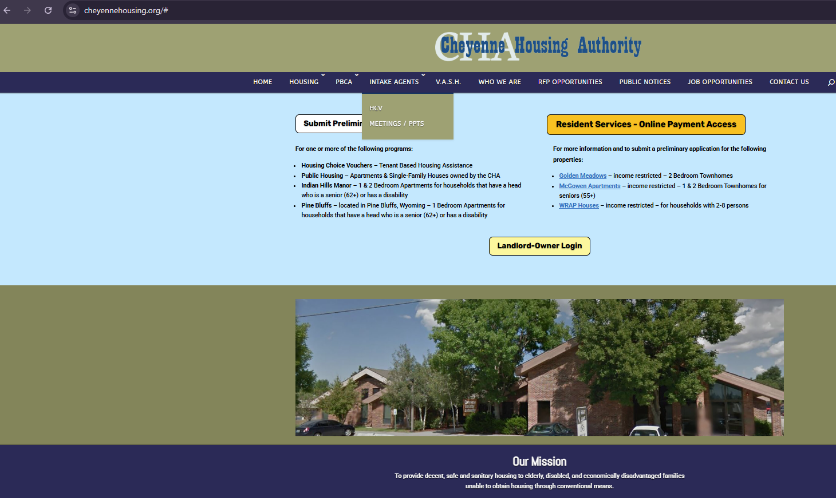
Resources and documents are available through our website!
http://www.cheyennehousing.org
Are there other documents that would be helpful?

Slide 7

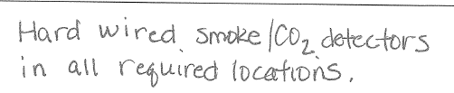

Inspection Reminders:
  NSPIRE postponed to February 2027
    KEEP your NSPIRE book on hand
  QC Inspections June 8-12th
    Tell tenants we will be back!
  Your New Stick ☺
    Product demonstration – THANK YOU Al!!!
  Co2 & Smoke Detector notes on Page 8; examples:

Slide 8
Inspection Reminders:
Failed Inspections:
  Take pictures!
  Send Failed Letter
  All to Amanda
Confirm with Amanda if you have reason to doubt if an inspection is necessary:
  If they are moving in the future, the inspection still needs to be done now.
You DO NOT have to inspect an infestation IF both the Landlord and the Tenant agree.
  Document on the inspection form
  Get proof of treatment plan
  Get to Amanda
  Schedule check-in and re-inspection when the unit when reported it’s clear

Slide 9

Call any time
Let me know of any quarterly topic ideas
See you in June!!!

