Slide 1
CHA Intake Agent Meeting & NSPIRE Update
December 2025

Slide 2
Today’s Agenda:
Introductions / Roll Call
Contact Updates
CHA website tab for Intake Agent resources
HCV Waitlist process and estimates
Recertifications process and timelines
Inspection Types Overview
Important Reminders
NEW payment standards and utility allowances
Other Questions

Slide 3

Introductions:
Sherrie
In
Gillette & Wright
Michelle in Sheridan
Jan in
Buffalo
Susan in Cody &
Powell
Angela in Riverton & Lander
Mike & Louis & Lisa in Rawlins
Kaylee in Laramie
Al in Cheyenne
This Photo by Unknown Author is licensed under CC BY-SA

Slide 4
CHA Contact information:
The case managers in Section 8 current tenant Vouchers are assigned by the tenant’s last name
(aka annual or special inspections):
  A – G: Jemini Hernandez; jhernandez@cheyennehousing.org; 307-633-8301
  H – 0: Wendy Renteria; wrenteria@cheyennehousing.org; 307-633-8322
  P – Z: Nicole Stock; nstock@cheyennehousing.org; 307-633-8336
  Please note all annual inspection results should be emailed to Amanda.
The Eligibility team works with applicants throughout the process of receiving a Section 8 Voucher:
  Eligibility@cheyennehousing.org
Housing Programs Director / HCV QC Inspector: Amanda Allard; 307-633-8314; aallard@cheyennehousing.org
Cheyenne HCV Inspector / NSPIRE expert: Al Dubois; 307-630-1553; adubois@cheyennehousing.org

Slide 5
Inspection Questions???

Slide 6
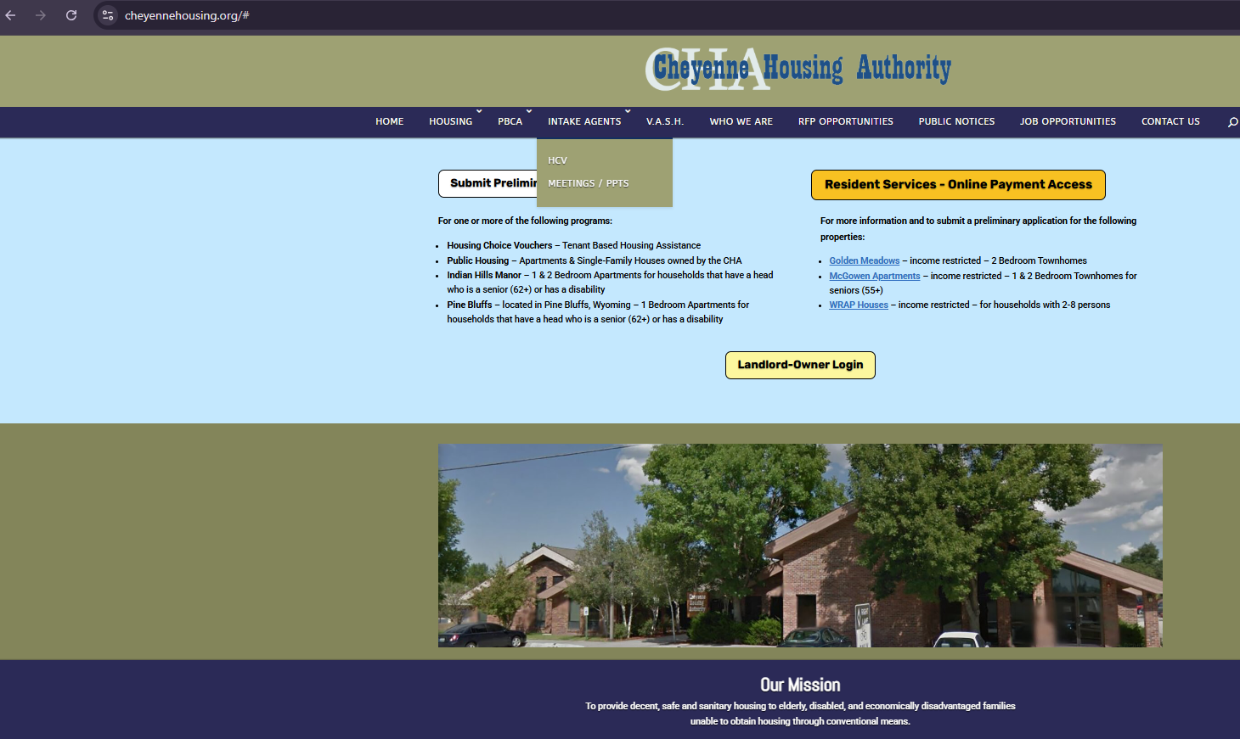
Resources and documents are available through our website!
http://www.cheyennehousing.org
Are there other documents that would be helpful?

Slide 7
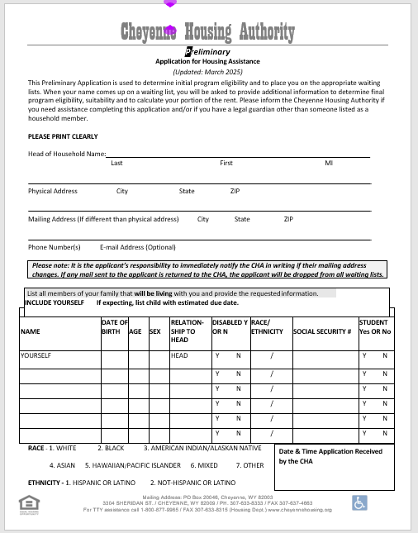
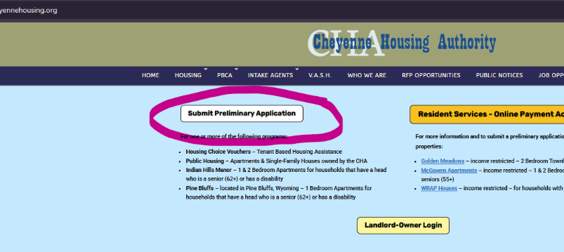
HCV Waitlist - Preapplications:
A pre-application must be completed to be added to the CHA HCV waiting list.
  Paper packet (all 4 pages) or through Rent Café
  Must include a mailing address!
    Returned mail = removal from waiting list
  We do not need any supporting documents with pre-application.
  You can email it to us to help the customer!

Slide 8
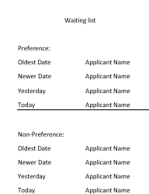
HCV Waitlist – Process & Estimates:
There are currently 2,946 applicants on the waiting list. 284 have preference.
“Preference” is given those that live in our jurisdictional area AND :
  Are elderly (62+), or
  Disabled, or
  Have dependents
Preferences are not stacked.
There is no preference for homelessness or domestic violence scenarios.
We do not have emergency housing.
Currently the estimated wait times:
  With preference is 9-12 months
  Without preference 5+
What questions do you hear from customers or landlords?

Slide 9
Recertifications process and timelines:
There are annual recertifications; based on month of move-in.
The recertification does not always align with their bi-annual inspection month.
Verifications can be emailed from your office to help the customer.

Slide 10
Inspections Overview:
Annual – requested from Amanda:
  Completed for tenants every 2 years (can be sooner, but NO later!)
  Sent 2-3 months in advance to provide ample time to complete
  As long as inspection is done within the due date (pass or fail, we are good)
  MUST complete by HUD due dates.
Initial - requested by Eligibility / HCV:
  Are done with the tenant is first moving in / getting voucher
  Date completed impacts how soon we start paying rent - ASAP
Special – requested by HCV Housing Specialist:
  HQS Deficiencies:
    No hot water
    Heater broken (in winter)
    Infestation
    Etc.
  Reasonable Accommodations Verifications:
  Use of 2nd bedroom for:
    Medical supplies
    Exercise equipment
    Specified craft

Slide 11
Important Reminders:
Failed Inspections:
  Take pictures!
  Send Failed Letter
  All to Amanda
Confirm with Amanda if you have reason to doubt if an inspection is necessary:
  If they are moving in the future, the inspection still needs to be done now.
You DO NOT have to inspect an infestation IF both the Landlord and the Tenant agree.
  Document on the inspection form
  Get proof of treatment plan
  Get to Amanda
  Schedule check-in and re-inspection when the unit when reported it’s clear

Slide 12
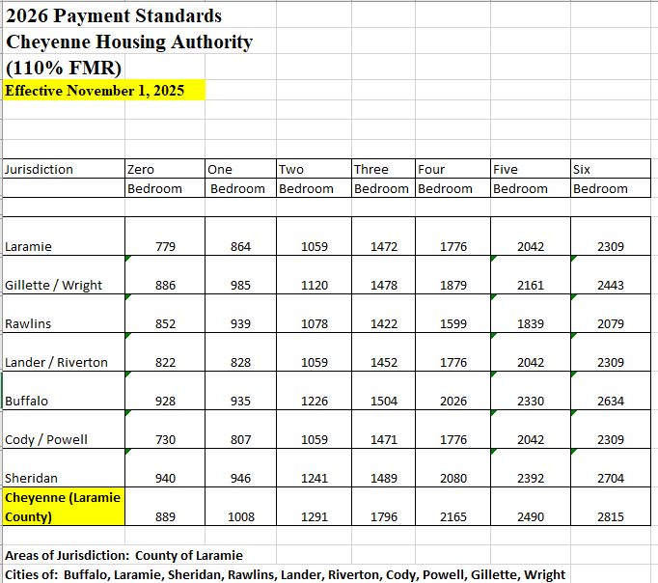
Effective 11/1/2025
Different for VASH
Utility Allowances went up slightly as well

Slide 13

Call any time
Let me know of any quarterly topic ideas

