Slide 1
CHA Intake Agent Meeting & NSPIRE Update
09/26/2025

Slide 2
Today’s Agenda:
Introductions / Roll Call
Contact Updates
Communications
Inspection Types Overview
Important Reminders
Carbon Monoxide & Smoke Detectors
Common Questions / Additions by Room
NSPIRE-V Standards Delayed (again) until February 2027
US Inspection Group NSPIRE-V Reference book & 2-minute videos
NEW payment standards and utility allowances
Other Questions

Slide 3
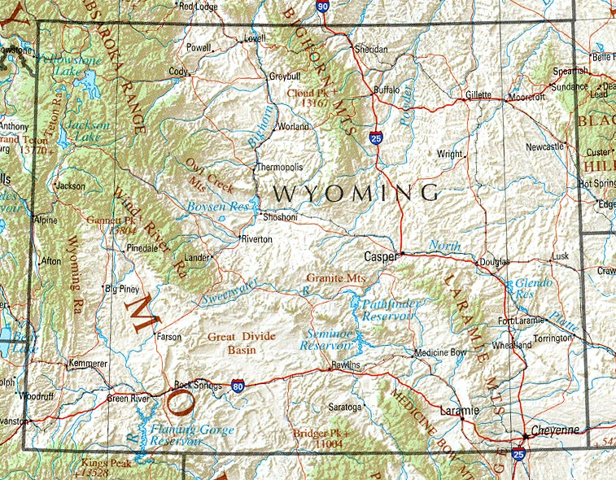
Introductions:
Sherrie
In
Gillette
Michelle in Sheridan
Jan in
Buffalo
Susan in Cody &
Powell
Angela in Riverton & Lander
Mike & Sonia in Rawlins
Kaylee in Laramie
Al in Cheyenne
This Photo by Unknown Author is licensed under CC BY-SA

Slide 4
CHA Contact information:
The case managers in Section 8 current tenant Vouchers are assigned by the tenant’s last name
(aka annual or special inspections):
A – G: Jemini Hernandez; 307-633-8301; jhernandez@cheyennehousing.org
H – 0: Jenny Parsons; 307-633-8338; jparsons@cheyennehousing.org
P – Z: Nicole Stock; 307-633-8336; nstock@cheyennehousing.org
Please note all annual inspection results should be emailed to Amanda.
The Eligibility team works with applicants throughout the process of receiving a Section 8 Voucher:
Eligibility@cheyennehousing.org
Housing Programs Director / HCV QC Inspector: Amanda Allard; 307-633-8314; aallard@cheyennehousing.org
Cheyenne HCV Inspector / NSPIRE expert: Al Dubois; 307-630-1553; adubois@cheyennehousing.org

Slide 5
Inspections Overview:
Annual – requested from Amanda:
Completed for tenants every 2 years (can be sooner, but NO later!)
Sent 2-3 months in advance to provide ample time to complete
As long as inspection is done within the due date (pass or fail, we are good)
MUST complete by HUD due dates.
Initial - requested by Eligibility / HCV:
Are done with the tenant is first moving in / getting voucher
Date completed impacts how soon we start paying rent - ASAP
Special – requested by HCV Housing Specialist:
HQS Deficiencies:
No hot water
Heater broken (in winter)
Infestation
Etc.
Reasonable Accommodations Verifications:
Use of 2nd bedroom for:
Medical supplies
Exercise equipment
Specified craft

Slide 6
Important Reminders:
Failed Inspections:
Take pictures!
Send Failed Letter
All to Amanda
Confirm with Amanda if you have reason to doubt if an inspection is necessary:
If they are moving in the future, the inspection still needs to be done now.
You DO NOT have to inspect an infestation IF both the Landlord and the Tenant agree.
Document on the inspection form
Get proof of treatment plan
Get to Amanda
Schedule check-in and re-inspection when the unit when reported it’s clear

Slide 7
Smoke and Carbon Monoxide Detectors:
THESE ARE NOT N-SPIRE STANDARDS; C02 WAS EFFECTIVE 10/1/2024 & SMOKE DETECTORS WAS 12/23/24
For units serviced by any fuel-fired (gas, wood, oil, etc) appliances, they must have a carbon monoxide detectors installed within “the immediate area” of sleeping.
Carbon monoxide detectors must be installed in units with attached garage.
All smoke detectors be hardwired OR contain a 10-year tamper resistant battery.
Each level of the unit (including basement) must have a smoke detector AND a detector in each sleeping room AND outside the common area of bedrooms.
Smoke detectors mounting on the ceiling should be more than 4 inches from the wall. If mounted on the wall, they should be between 4-12 inches from the ceiling.
Basement smoke detectors should be installed on the ceiling at the bottom of the stairs leading to the next level.
No detectors should be installed near (closer than 3 feet) windows, doors or vents.

Slide 8
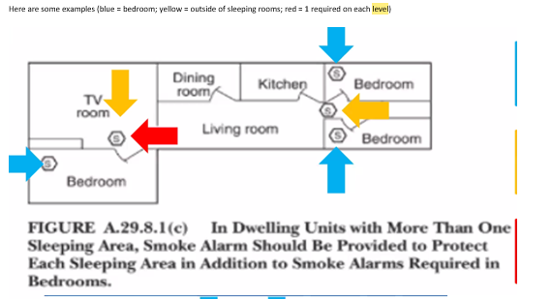
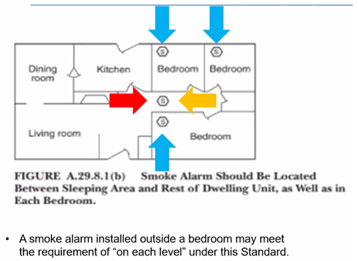
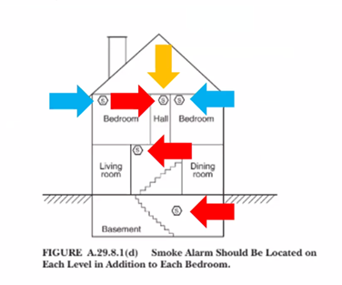
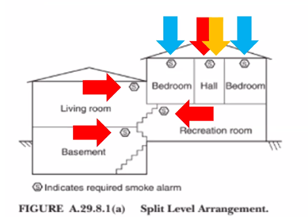

Slide 9
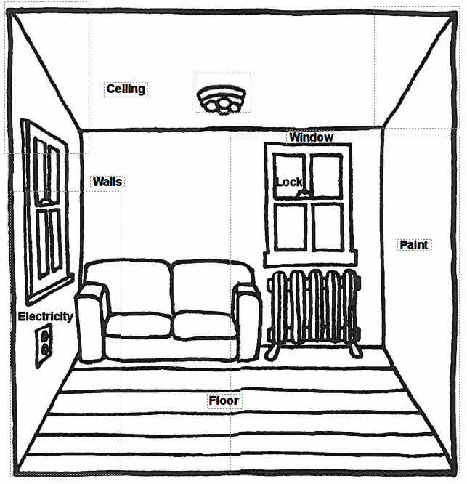
Living Room – Additions:
Ceiling – sagging ceilings:
Is it hard and dry, or
Soft and wet?
Walls – 2” hole or cumulative holes more than 6”x 6” or holes that penetrate into other rooms.
Electrical – 1 permanent light and 1 outlet or 2 outlets.
Floor – 10% of floor covering is missing or soft spots (especially in trailer homes.
Windows –
Breaks okay if not a hazard and keeps weather out.
Windows must lock – sticks are not acceptable.

Slide 10
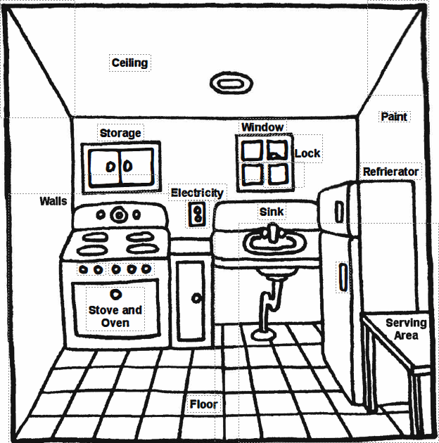
Kitchen– Additions:
Electrical – outlets that are within 6’ of a water source must be GFI or on a GFI circuit - NSPIRE
Cooking Appliance – A microwave oven can be used for cooking IF agreed upon in writing by the tenant and landlord.
Dishwasher – NOT required, but if are installed must work – NSPIRE
Kitchen sink cannot be the same as the bathroom sink.

Slide 11
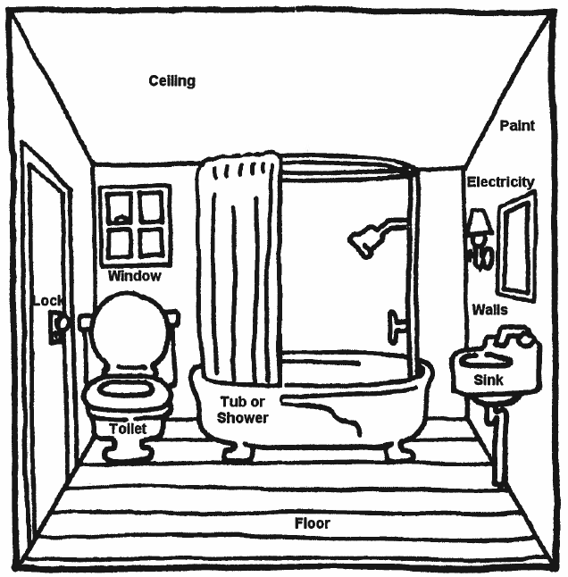
Bathroom– Additions:
Must have either a vent or an openable window. Vents do not require a fan, but if an electric fan is installed it must work.
If there are multiple bathrooms present, then severe defects change to moderate.
Bathroom sink cannot be the same as the kitchen sink.

Slide 12
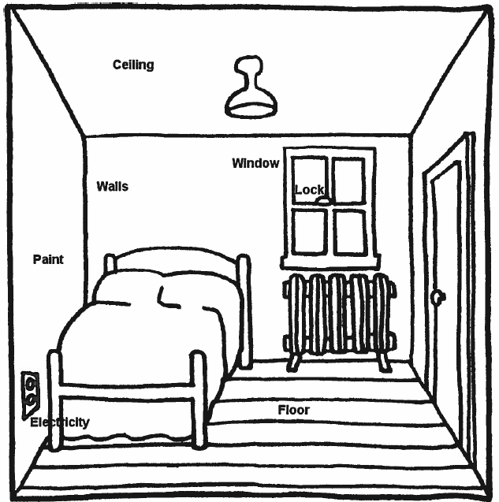
Other Rooms– Additions:
All sleeping rooms must have a smoke detector.
Smoke detectors must be hardwired or have a ten-year tamper proof battery.
Carbon Monoxide tester must be present if there are any gas appliances.

Slide 13
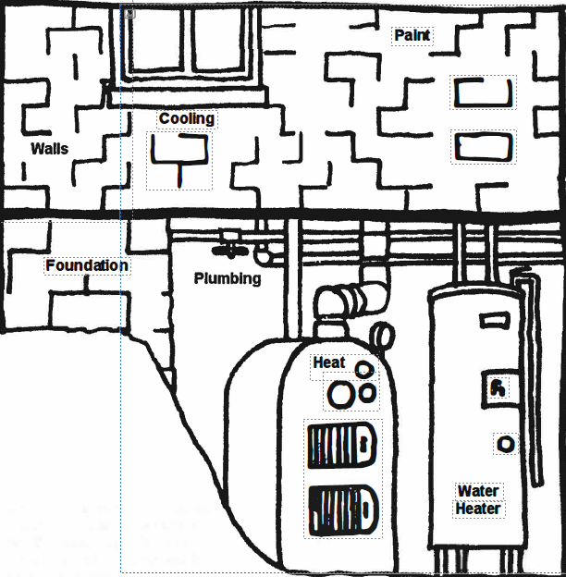
Other Rooms– Additions:
Egress
Water Heater TRP value length
No shorter than 4 inches from floor
2-6 inches from lip of drip pan or floor – NSPIRE
Mold

Slide 14
NSPIRE – V: Delayed 02/01/2027
HUD is replacing the HQS inspections with the new National Standards for Physical Inspection of Real Estate requirements.
These new standards prioritize the health and safety of the residents above all else and are higher expectations than the HCV program has been held to before.
Effective 02/01/2027:
Any initial or special inspections done 02/01/2027 and after
Annual inspections completed after 02/01/2027
NOTE: We are not required to do NSPIRE inspections until the
current tenant’s bi-annual inspection comes due.

Slide 15

Page 2 – GFCI testing
Page 10 – Refrigerator damage
Page 12 – Fire Door
Page 14 – Electrical Gaps
Dryer Vent
Auxiliary Lights
Page 16 – Fire Sprinklers
Page 20 – Water Heater
Page 22 – Grab bars
Cooking Range
Page 26 – Egress
Fire Extinguisher
Page 28 – Carbon Monoxide & Smoke Detectors

Slide 16

USIG –NSPIRE in 2 minute Topics
Growing library of 2 minute videos

Slide 17
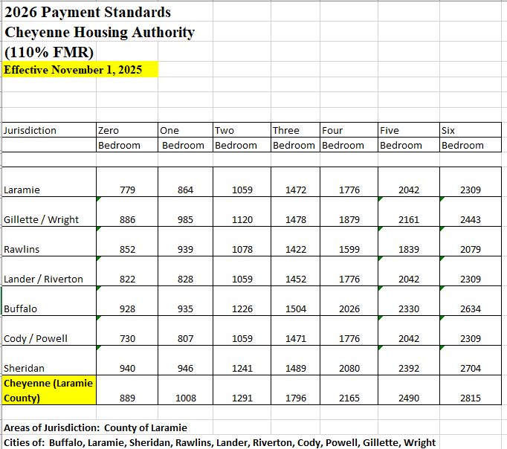
Effective 11/1/2025
Different for VASH
Utility Allowances went up slightly as well

Slide 18

Call any time Let me know of any quarterly topic ideas Power Point Slide, Payment Standards, and Utility Allowances will be emailed to you and saved on our website under Intake Agents / Meetings & PPTs

