Slide 1
CHA Intake Agent Meeting
10/30/24

Slide 2
Today’s Agenda
Introductions
Contact Updates
Communications
Inspection Types Overview
Highlights
Voucher Program updates & Timelines
Inspection Letters
Failed Inspection Letters & Timeframes
Your questions

Slide 3
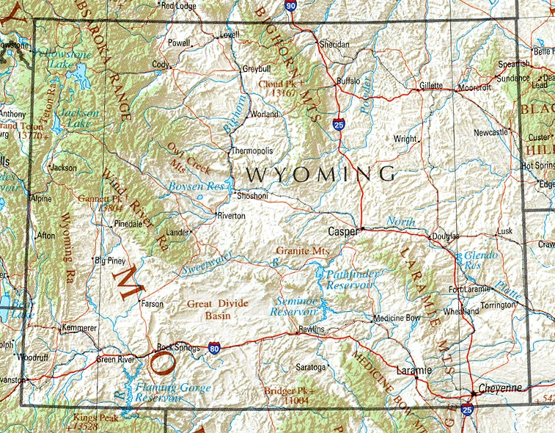
Introductions:
Sherrie
In
Gillette
Kelsey in Sheridan
Jan in
Buffalo
Susan in Cody &
Powell
Marla & Angela in Riverton & Lander
Velena & Sonia in Rawlins
Kaylee in Laramie
Al in Cheyenne
This Photo by Unknown Author is licensed under CC BY-SA

Slide 4
CHA Contact information:
The case managers in Section 8 current tenant Vouchers are assigned by the tenant’s last name
(aka annual or special inspections):
  A – G: Jessica Rodriguez; 307-633-8338; jrodriguez@cheyennehousing.org
  H – 0: Elizabeth Journey; 307-633-8338; ejourney@cheyennehousing.org
  P – Z: Teresa Chizek; 307-633-8336; tchizek@cheyennehousing.org
  Please note all annual inspection results should be emailed to Amanda.
The Eligibility team works with applicants throughout the process of receiving a Section 8 Voucher:
  Renee Lynn; 307-633-8331; Rlynn@cheyennehousing.org
Housing Programs Director / HQS QC Inspector: Amanda Allard; 307-633-8314; aallard@cheyennehousing.org
Cheyenne HQS Inspector / NSPIRE expert: Al Dubois; 307-630-1553; adubois@cheyennehousing.org

Slide 5
Communications:
Calls are okay but emails are better
Be sure to list applicant name in the subject line
Attaching inspections as PDFs saved by tenant name is ideal!
If you schedule an initial inspection days out please let Eligibility know otherwise we will send follow-up emails every 5 days.
Al is a great resource!

Slide 6
Inspections Overview:
Annual – requested from Amanda
  Completed for tenants every 2 years (can be sooner, but NO later!)
  Sent 2-3 months in advance to provide ample time to complete
  As long as inspection is done within the due date (pass or fail, we are good)
  MUST complete by HUD due dates.
Initial - requested by Eligibility
  Are done with the tenant is first moving in / getting voucher
  Date completed impacts how soon we start paying rent - ASAP
Special – requested by case managers
  HQS Deficiencies:
    No hot water
    Heater broken (in winter)
    Infestation
    Etc.
  Reasonable Accommodations Verifications:
  Use of 2nd bedroom for:
    Medical supplies
    Exercise equipment
    Specified craft

Slide 7
Highlights:
NSPIRE delayed until October 2025
  In Cheyenne we have been doing inspections by buildings, and looking at properties in preparation for NSPIRE.
  Don’t use the new checklists yet ☺
  GFI outlets with NSPIRE (tell Landlords now)
  TRP valve on hot water heaters (tell Landlords now)
  2-minute videos: US Inspection Group – NSPIRE In 2 Minutes
Carbon Monoxide alarms are required effective 10/1/24
  Where required / how do we know?
  PLEASE HAND WRITE ON THE LAST PAGE OF THE INSPECTION FORM
Hardwired or tamperproof 10 year battery smoke detectors are required effective 12/23/24.
  Where required / how do we know?
  PLEASE HAND WRITE ON THE INSPECTION FORM
Is the tenant emails, Landlord information, and VASH caseworker helpful?
Any other suggestions to add to the monthly list?

Slide 8
Voucher Program Updates
& Timelines:
We are currently utilizing 100% of our allotted HUD vouchers;
UNTIL 12/2/24 – we are about to start issuing again now!
We finished the wait list clean-up project, so all applicants have confirmed they are still in need; The waiting list is currently 2300+; with 915+ receiving preference.
12/1/24 Payment Standards & Utility allowances
  Are going down!
  Effective with lease-ups on/after 12/1/24
  Amanda will send jurisdictional area specific details

Slide 9
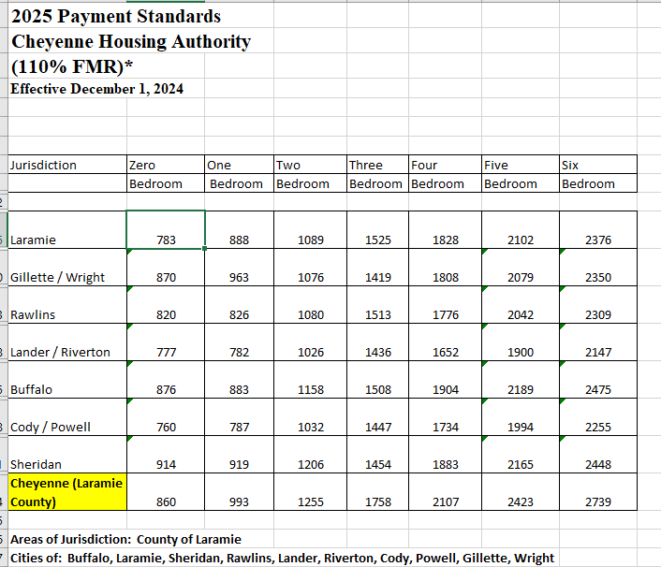
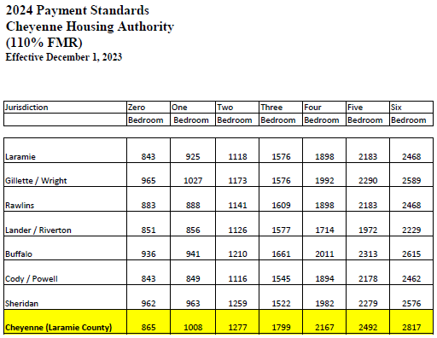

Slide 10
Failed Inspections & Timeframes
Quick fixes
Discuss 24 hours vs 30 days corrections
CHA must be provided a copy of the letter for our files
NOTE: Initial inspections do not have required timeframes to correct an issue. If the failed item(s) are not corrected the applicant will not be approved with Voucher assistance at that unit --- keeping in mind the expiration of the voucher date.

Slide 11
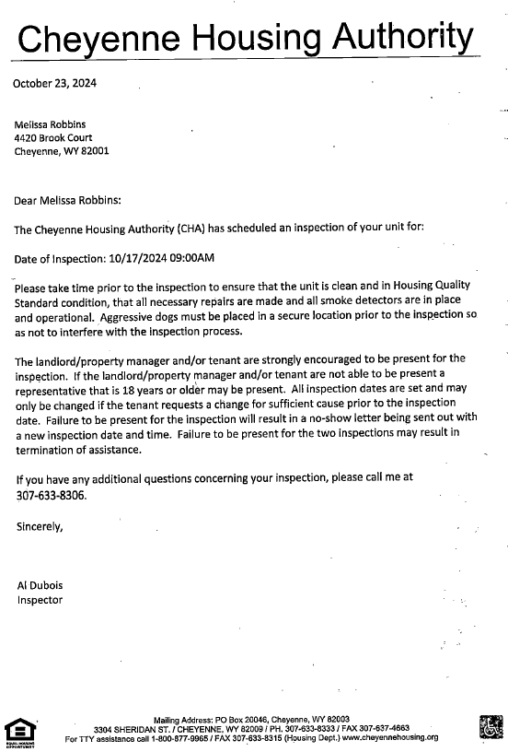
Scheduling Inspection Letter

Slide 12
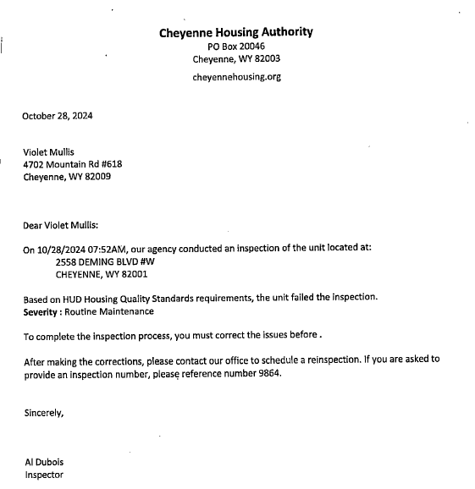
Failed Inspection Letter

Slide 13
What questions or suggestions do you have?

