Slide 1
CHA Intake Agent Meeting
01/30/24

Slide 2
Today’s Agenda
Introductions
Contact Updates
Communications
Random Shares
Voucher Program updates & Timelines
Inspection Types Overview
Failed Inspection Letters & Timeframes
New Inspection Updates - NSPIRE
Your questions

Slide 3
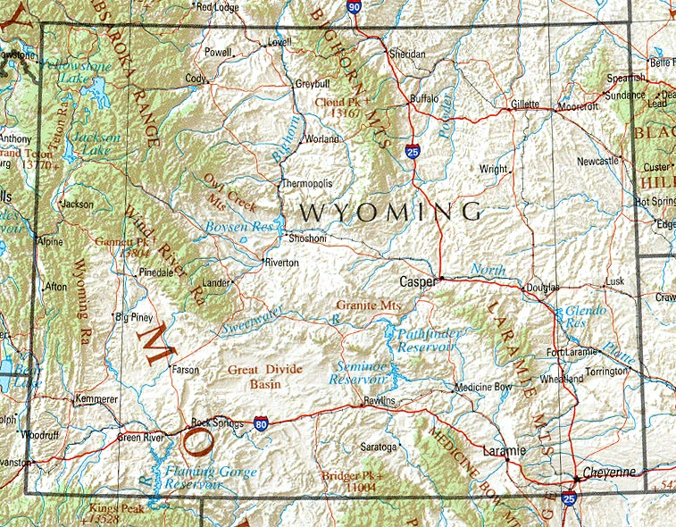
Introductions:
Sherrie
In
Gillette
Trisha in Sheridan
Jan in
Buffalo
Susan in Cody &
Powell
Jane / Marla in Riverton & Lander
Sonia in Rawlins
Kaylee in Laramie
Al in Cheyenne
This Photo by Unknown Author is licensed under CC BY-SA

Slide 4
CHA Contact information:
The case managers in Section 8 current tenant Vouchers are assigned by the tenant’s last name
(aka annual or special inspections):
  A – G: Aletha Current; 307-633-8338; acurrent@cheyennehousing.org
  H – 0: Sylvia Garza; 307-633-8322; sgarza@cheyennehousing.org
  P – Z: Teresa Chizek; 307-633-8336; tchizek@cheyennehousing.org
  Please note all annual inspection results should be emailed to Amanda.
The Eligibility team works with applicants throughout the process of receiving a Section 8 Voucher:
(aka initial inspections):
  Christy Henson; 307-633-8329; chenson@cheyennehousing.org
  Janelle Leonard; 307-633-8335; jleonard@cheyennehousing.org
  Renee Lynn; 307-633-8331; Rlynn@cheyennehousing.org
  Please note all initial inspection results should be emailed to Janelle & Renee.
Housing Programs Director / HQS QC Inspector: Amanda Allard; 307-633-8314; aallard@cheyennehousing.org

Slide 5
Communications:
Calls are okay but emails are better
Be sure to list applicant name in the subject line
Attaching inspections as PDFs saved by tenant name is ideal
If you schedule an initial inspection days out please let Eligibility know otherwise we will send follow-up emails every 5 days.

Slide 6
Random Shares:
Pre-applications only require the 3 page form; we do not need all of the supporting documents – that is requested when they are selected from the waiting list and complete the new intake packet.
QC Inspections in early June 2024!
Please help us tell Landlords:
  To share tenant issues – lease violations, termination, etc.
  Notify us before moving a tenant within their units
We do not pay for lot rent only when a customer owns their trailer unless they are grandfathered into the program from years ago.

Slide 7
Voucher Program Updates
& Timelines:
We are currently utilizing 100% of our allotted HUD vouchers.
We can only issue more each month as existing tenants get off of the program – average about 20 a month.
The waiting list is currently 2700+; with 475+ receiving preference.
  At the current rate it will be an estimated 12-24 months before applicants are selected with preference.
We will be sending out “save my spot” notices to clean up the waiting list; starting with non-preference oldest applications first
  We can request to save their spot on Rent Café or submit in writing
  (e-mail via you is okay too).

Slide 8
Inspections Overview:
Annual – requested from Amanda
  Completed for tenants every 2 years
  Sent 2-3 months in advance to provide ample time to complete
  MUST complete by HUD due dates.
Initial - requested by Eligibility
  Are done with the tenant is first moving in / getting voucher
  Date completed impacts how soon we start paying rent - ASAP
Special – requested by case managers
  HQS Deficiencies:
    No hot water
    Heater broken (in winter)
    Infestation
    Etc.
  Reasonable Accommodations Verifications:
  Use of 2nd bedroom for:
    Medical supplies
    Exercise equipment
    Specified craft

Slide 9
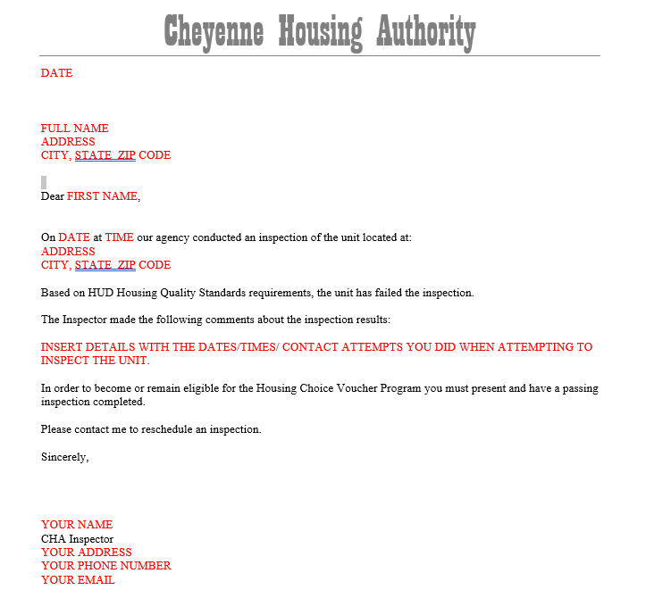
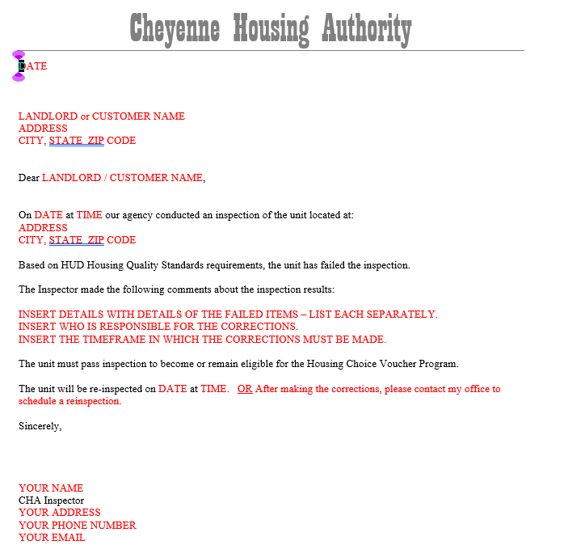
Failed Inspection Letters
& Timeframes
Quick fixes
Discuss 24 hours vs 30 days corrections - CHA has to have a copy of the letter
NOTE: Initial inspections do not have required timeframes to correct an issue. If the failed item(s) are not corrected the applicant will not be approved with Voucher assistance at that unit.

Slide 10
New Inspection Updates: NSPIRE
Al & Amanda will be attending an industry training specific to Landlords for the transition from HQS to NSPIRE in February. We will share that information with you and also offer Landlords to consider signing up for – we cannot pay for it.
Overview
New checklist

Slide 11
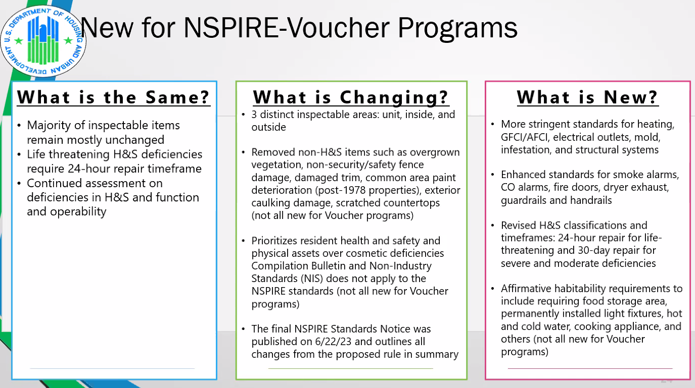

Slide 12
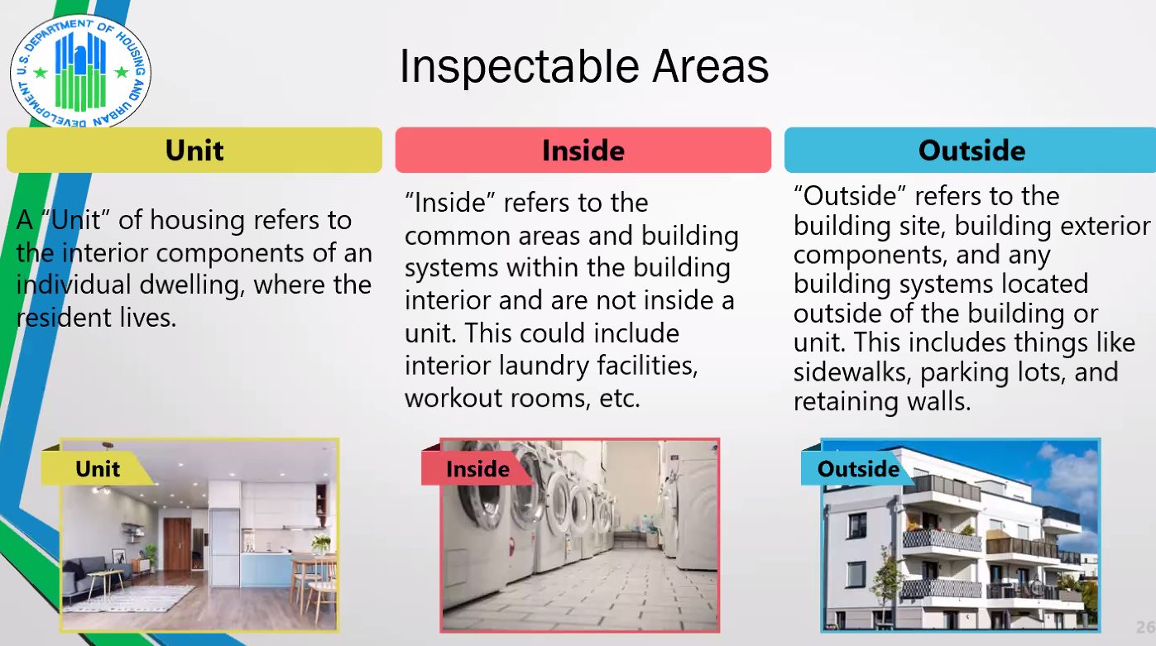

Slide 13


Slide 14
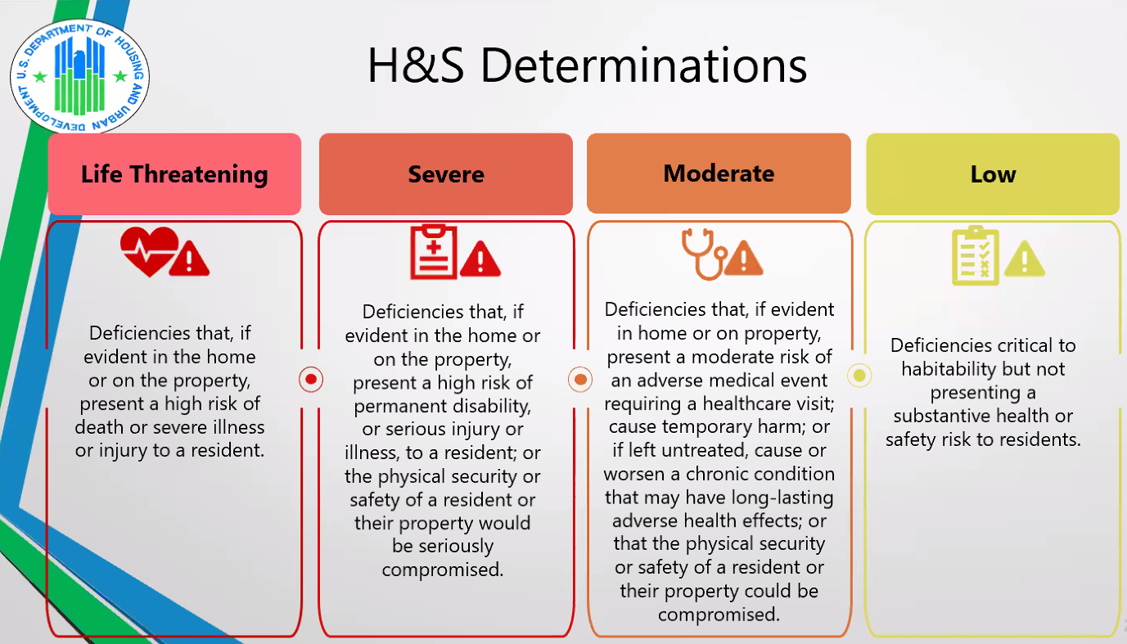

Slide 15
NSPIRE Checklist

Slide 16
What Questions or Suggestions
Do you have?

