Slide 1
CHA Intake Agent Meeting
9/15/23

Slide 2
Today’s Agenda
Introductions
Contact Updates
New Inspection Updates
Special Inspections Overview
Landlord Relationship & Talking Points
Communications
Future Plans
Your questions

Slide 3
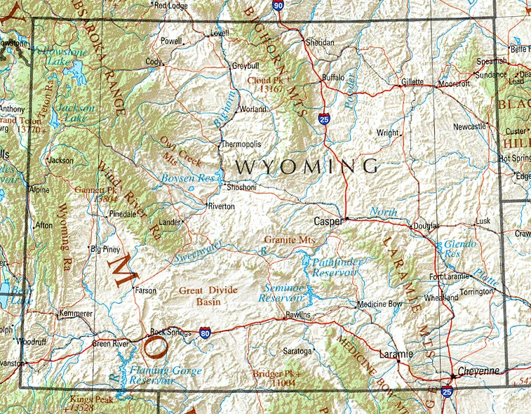
Introductions:
Sherrie
In
Gillette
Trisha in Sheridan
Jan in
Buffalo
Susan in Cody &
Powell
Jan in Riverton & Lander
Sonia in Rawlins
Kaylee in Laramie
Al in Cheyenne
This Photo by Unknown Author is licensed under CC BY-SA

Slide 4
CHA Contact information:
The case managers in Section 8 current tenant Vouchers are assigned by the tenant’s last name
(aka annual or special inspections):
  A – G: Aletha Current; 307-633-8338; acurrent@cheyennehousing.org
  H – 0: Hannah Gillis; 307-633-8322; hgillis@cheyennehousing.org
  P – Z: Teresa Chizek; 307-633-8336; tchizek@cheyennehousing.org
  Please note all annual inspection results should be emailed to Amanda.
The Eligibility team works with applicants throughout the process of receiving a Section 8 Voucher:
(aka initial inspections):
  Christy Henson; 307-633-8329; chenson@cheyennehousing.org
  Janelle Leonard; 307-633-8335; jleonard@cheyennehousing.org
  Renee Lynn; 307-633-8331; Rlynn@cheyennehousing.org
  Please note all initial inspection results should be emailed to Janelle & Renee.
Housing Programs Director / HQS QC Inspector: Amanda Allard; 307-633-8314; aallard@cheyennehousing.org

Slide 5
New Inspection Updates: NSPIRE
HUD is replacing the HQS inspections with the new National Standards for Physical Inspection of Real Estate requirements.
The implementation of these changes have been delayed until October 1, 2024.
  HOWEVER, there are many things we want to start preparing our Landlords and Tenants for now.
  We anticipate new inspection forms but have no updates at this time.
These new standards prioritize the health and safety of the residents above all else and are higher expectations than the HCV program has been held to before.
There are no HUD defined assignment of responsibilities for corrections. The inspector will define who must address each deficiency.

Slide 6
NSIRE Highlights:
There are now 3 specified areas when doing each inspection:
  Outside (property site and exterior of the property).
  Inside (common areas in property buildings such as hallways, elevators, gyms, meeting spaces, etc)
  Unit (within the specific tenant unit)
There are 3 deficiency categories:
  Low
    Passes with comments
  Moderate
    Fail – 30 Day Repair
  Severe
    Fail – 30 Day Repair
    Life Threatening; - 24 Hour Repair

Slide 7
IMPORTANT NSPIRE Requirements:
Things we want to start telling people - NOW – to prepare for 10/1/2024
GFCI protected outlets are now required at all “wet” locations; including the exterior and other areas within 6 feet of a water source (kitchen, bathroom).
  We are looking into City Code for this as we know some new constructions don’t have this right now.
Properties and buildings must be identified adequately to allow First Responders to quickly locate the property or individual buildings.
Any missing knockouts or foreign material used for electrical repairs will be considered defective, as will severe rust noted inside the enclosure.
Fire Sprinklers cannot have any items stored within 18inches of the head. This is a 24 hour repair item.

Slide 8
Tell Landlords NOW:
Smoke and Carbon Monoxide Detectors:
Each level of the unit (including basement) must have a smoke detector AND a detector in each sleeping room AND outside the common area of bedrooms.
Smoke detectors mounting on the ceiling should be more than 4inches from the wall. If mounted on the wall, they should be between 4-12 inches from the ceiling.
Basement smoke detectors should be installed on the ceiling at the bottom of the stairs leading to the next level.
For units serviced by any fuel-fired (gas, wood, oil, etc) appliances, they must have a carbon monoxide detectors installed within “the immediate area” of sleeping.
Carbon monoxide detectors must be installed in units with attached garage.
No detectors should be installed near (closer than 3 feet) windows, doors or vents.
By December 2024, HUD is going to be requiring that all smoke detectors be hardwired (VERY EXPENSIVE) OR contain a 10-year tamper resistant battery (cost is about $20 – almost equal a standard detector.

Slide 9
Special Inspections Overview:
HQS Deficiencies:
  No hot water
  Heater broken (in winter)
  Infestation
  Etc.
Reasonable Accommodations Verifications:
  Use of 2nd bedroom for:
    Medical supplies
    Exercise equipment
    Specified craft

Slide 10
Landlord Relationship & Talking Points:
Importance of Landlords to the Voucher program
Our website for Landlords information & the portal https://www.cheyennehousing.org/
Building contacts and a jurisdictional landlord list
Outreach & Flyers

Slide 11
Communications:
Calls are okay but emails are better
Be sure to list applicant name in the subject line
Attaching inspections as PDFs saved by tenant name is ideal
Annual Inspections:
  Timing
  Report list
  Follow-up questions

Slide 12
Future Plans:
Quarterly Meetings
NSIPRE Updates
Best Practice Sharing
Outreach suggestions
Process questions and other training opportunities
What day / time is best for the group for a quarterly meeting?

Slide 13
What Questions or Suggestions
Do you have?

