Slide 1


Welcome to the
Cheyenne Housing Authority
Issuance of a Housing Choice Voucher
Notes:
Welcome and thank you for attending this meeting about how the Housing Choice Voucher program works. This presentation will explain the requirements and expectations of how to become a program participant and what the family obligations are in order to remain as a participant on the Voucher program.

Slide 2


What we will accomplish today:
  Program overview - Online resources
  How to Request a Reasonable Accommodation
  Voucher Information review
  The approval process of the Unit
  Family Obligations after move-in
  (Lease with your Landlord / Family obligations with the CHA)
  Grounds for termination
  Answering your questions …
  Completing online applications
  Uploading documents provided
  Take your fingerprints
Notes:
In the meeting today we will be going over the Voucher program and resources that are available to you, the approval process of the unit you wish to lease with your Voucher, your family obligations to continue to participate in the program. We will also answer questions and after the group presentation, your fingerprints can be taken for the criminal background check. We will meet with you individually after the group presentation at which time you may ask any questions that may be of a personal nature. A criminal background check is required in order to participate in the program. After the group meeting, a CHA representative will be able to take your fingerprints. The actual background check will not be completed until you have submitted information to this office on the unit you would like to rent with your Voucher. If you live in one of CHA’s jurisdictions that is not Cheyenne, you will be provided information as to how you can submit your fingerprints.

Slide 3


Program Overview – online for easy access and review
- Briefing Video | Cheyenne Housing Authority
- Description of how the program works
- Housing Agency’s responsibility
- Family responsibilities overview
- Landlord Responsibility
- Forms you need to complete
- your responsibilities on the program
- HCV Briefing Packet | Cheyenne Housing Authority
- A Good Place to Live
- Voucher Terms /extensions
- Maximum allowable rent
- Payment standards and utility allowance
- RFTA form
- Tenancy Addendum
- What you should know about EIV
- Requesting a Reasonable Accommodation
- and more…
CheyenneHousing.org
Notes:
There are a lot of resources and documents available to you on the Cheyenne Housing Authority’s website at cheyennehousing.org. On the home webpage, click on Housing and then HCV Briefing packet. Listed are the items in the briefing packet. If you would like a paper version of any of these individual documents or the entire briefing packet, please let us know. You can also find this presentation on CHA’s website should you wish to re-review it.

Slide 4
Reasonable Accommodation/Modifications Requests
A reasonable accommodation is a change, exception, or adjustment to a rule, policy, practice, or service that may be necessary for a person with disabilities to have an equal opportunity to use and enjoy a dwelling, including public and common use spaces, or to fulfill their program obligations.
A reasonable accommodation or modification may be requested at any time either verbally or in writing.
CHA will provide a form that you may but are not required to use that indicates what information CHA will need to evaluate your request.
Verification from a Qualified Individual such as a doctor or other medical professional, peer support group, non-medical service agency, or reliable third party who is in a position to know about the individual’s disability can also but is not required to be provided on this form.
If you require a reasonable accommodation or modification, please let us know so that we can be of assistance in this process.
Notes:
A reasonable accommodation is a change, exception, or adjustment to a rule, policy, practice, or service that may be necessary for a person with disabilities to have an equal opportunity to use and enjoy a dwelling, including public and common use spaces, or to fulfill their program obligations. A reasonable accommodation or modification may be requested at any time either verbally or in writing. CHA will provide a form that you may but are not required to use that indicates what information is needed to evaluate your request. Verification from a Qualified Individual such as a doctor or other medical professional, peer support group, non-medical service agency, or reliable third party who is in a position to know about the individual’s disability can also but is not required to be provided on this form. If you require a reasonable accommodation or modification, please let us know so that we can be of assistance in this process.

Slide 5


Voucher
The Voucher is the family’s authorization to search for housing. The voucher is evidence that the PHA has determined the family to be eligible for the program
You have 120-days from the issuance date to find a suitable unit. As this is the maximum allotted time allowed by HUD, no further extensions can be approved
The voucher specifies the bedroom size that the family qualifies. (next slide)
- Under the unit size – will be covered by the CHA
- Over the unit size – Family will be responsible for the difference (40% rule)
Time will pause on your voucher once you have found a unit and turned in the required documents. At that point the CHA must determine if the unit you selected is suitable based on a variety of factors. All of this information what we will go over in the upcoming slides
Please read the entire Voucher as it lists all of the family’s Obligations under the program
You may be able to utilize your voucher at your current residence. Talk to your landlord first. This is the fastest way to get assistance!
Notes:
The Voucher that is being issued to you is authorization for you to search for a suitable housing unit and is evidence that you have been issued a Voucher by this housing authority. You have 120 days to use the Voucher or the Voucher will expire. There are no extensions beyond the 120 day limit. The Voucher also indicates the size of the Voucher being issued to your family and the obligations of the family while you are on the program. If you are already living in a unit, it may make sense for you to use your Voucher where you currently live. This is very possible. Check with your landlord to see if they are willing to work with the Voucher program.

Slide 6

Where you can utilize your Voucher from the Cheyenne Housing Authority
Cheyenne, Laramie County
Town of Laramie
Rawlins
Lander/Riverton
Cody/Powell
Sheridan
Buffalo
Gillette/Wright
Notes:
The Voucher that is issued to you by the Cheyenne Housing Authority can be utilized to lease a unit in Cheyenne, the town of Laramie, Rawlins, Lander/Riverton, Cody/Powell, Sheridan, Buffalo, Gillette and Wright Wyoming.

Slide 7

Portability
Possible to port/transfer your Voucher if you qualify
You must have lived in one of CHA’s jurisdictions when you submitted your preapplication to be placed on the waiting list.
You may port your Voucher after you have lived in one of CHA’s jurisdictions for one year
Notes:
You may be eligible to port or transfer your Voucher to another Housing Authority that has a Voucher program if you lived in one of CHA’s jurisdictions when you applied to be placed on the waiting list.
If you choose to lease in one of CHA’s jurisdictions, it is possible for you to port after one year. If you want to port your voucher, let the eligibility team know right away.

Slide 8


Subsidy Standards
Number of Bedrooms | Minimum number of persons | Maximum number of persons
Exceptions to subsidy standards
CHA will grant exceptions to normal occupancy standards when a family requests a larger size subsidy as a reasonable accommodation due to a disability need of a family member in the household.
Requirements for this exception:
  The request must be in writing
  Must state the need or justification
  Must include appropriate documentation
Health related reasons must be verified by a knowledgeable professional source unless the disability and the related request is apparent or otherwise known.
 | 1 | 1
1 | 1 | 2
2 | 2 | 4
3 | 3 | 6
4 | 4 | 8
5 | 5 | 10
The family will be given choice of which bedroom size is appropriate for their family as long as the number of family members is within the range listed in the chart.
Notes:
The Subsidy Standard for the Voucher program is basically the same as the bedroom size that is indicated on your Voucher. It is possible for you to lease a smaller or larger unit than what your Voucher size is as longer as you are within the program payment standard range which we will talk more about later. This means if you were issued a 1 bdrm Voucher but you would prefer to lease a 2 bdrm home, it is possible as long as you have enough income to pay any difference in the amount of rent and the payment standard. If you do not agree with the bedroom size you were issued, please bring this to the attention of a staff member and we will discuss with you why this bedroom size was issued and if it is possible to change. Certain requirements must be met to issue a Voucher bedroom size that does not conform to Sudsidy Standard chart indicated on the screen. As this chart shows, there must be at least 1 person per bedroom and no more than two people per bedroom.

Slide 9


Payment Standards
Cheyenne Housing Authority
Payment Standard - the maximum monthly assistance payment for a family assisted in the voucher program (before deducting the total tenant payment by the family).
Is based on the number of people in your household and the size of the unit you lease
Will affect the amount of housing assistance that is paid on your behalf
The amount varies depending on the jurisdiction you lease a unit
A chart of the current payment standards is included in your packet
The amount includes the average cost of utilities.
Notes:
The payment standard is the maximum amount the CHA will pay towards the rent and utilities for the indicated bedroom size and location. The amount includes the average cost of utilities. You will be responsible for paying 30% of your income towards the rent and utilities in addition to any amount that you exceed the payment standard. CHA cannot allow you to enter into a lease paying more than 40% of your income towards rent and utilities so there is an ultimate limit. When CHA calculates 30% of your income for rent and utilities, this amount is then deducted from the payment standard and this is what will be paid by the CHA. The payment standard chart is included with the documents provided with your Voucher.

Slide 10

Utility Allowances
You need to know what utilities you will be responsible for paying.
Will you be paying for
Heat?
Electricity for your Lights?
Water?
Sewer?
Trash?
The utility allowance is calculated based off what utilities your landlord says you are responsible for.
This Photo by Unknown author is licensed under CC BY.
Notes:
Utility Allowances – it is important to know what utilities you will be responsible for paying when searching for a unit to lease. When you find a unit that you are interested in, please check with the owner/landlord to see what utilities you will be responsible for paying and the fuels the utility. For example, is the heat gas or electric, what about the stove is it gas or electric and the hot water heater is it gas or electric. CHA will also need to know if you will be responsible for paying the water sewer and trash. We can help you figure out the amount for the average utility cost so it is important that you obtain this information from the landlord you might want to rent from. Remember, this is only the average utility cost. Your actual cost may be higher or lower depending on your individual usage. If you keep the heat set at a higher temperature then your actual cost may be higher. If you keep it at a lower temperature then you will be able to realize these savings.

Slide 11


How your share of the rent is calculated
Total Tenant Payment (TTP). The minimum amount a family will have to pay for rent and utilities. This figure is the greatest of: 30 percent of monthly adjusted income, 10 percent of monthly income, or the PHA minimum rent.
Maximum initial rent burden. (Rent Reasonableness) The maximum amount the family is allowed to pay for rent and utilities at initial leasing of a unit under the voucher program. If rent for the unit exceeds the PHA payment standard, this figure is 40 percent of monthly adjusted income.
Maximum subsidy. The maximum amount the PHA will pay the owner on the family’s behalf. This figure is obtained by subtracting the TTP from the payment standard.
Notes:
The family’s share of the rent and utilities is 30% of the adjusted gross income or 10% of the gross monthly income whichever is greater. This is called the Total Tenant Payment. If the family chooses to lease a unit where the rent and utilities are over the payment standard, then the family is required to 30% of their income towards rent and utilities in addition to the amount that exceeds the payment standard. Program requirements will not allow the family to enter into a lease under the Voucher program if the amount of rent and utilities will exceed 40% of the families’ income.

Slide 12

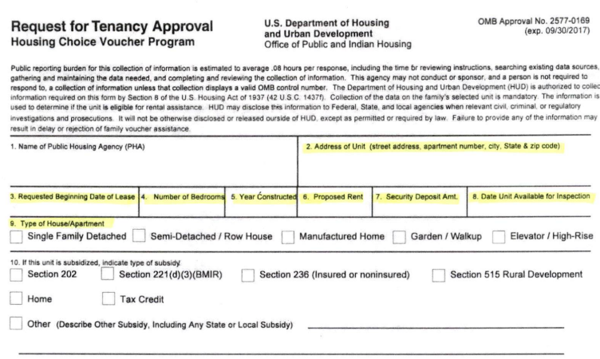
Before submitting the RFTA, be sure all highlighted fields are filled out completely and accurately by the Landlord
Notes:
This form that is in your packet is called a Request for Tenancy Approval and is a very important document to complete when you have found a unit that you would like to lease. Both you and your landlord will need to complete this document and submit it to the CHA office. It is extremely important that the entire document is completely filled out. The first section needs to indicate the address of the unit you will be renting, when you would like the lease to begin, the number of actual bedrooms in the unit, the year it was built, the proposed rent, security deposit and when the unit will be available for inspection. The security deposit is the family’s responsibility pay in full as the CHA does not assist with security deposits. CHA needs to know what type of unit it is. Is it a single family house, an apartment or a manufactured home. CHA does not assist with lot rent if you own the manufactured home. Section 10 describes other types of funding that may be attached to the unit. If this is the case, the landlord will know which one to check.

Slide 13
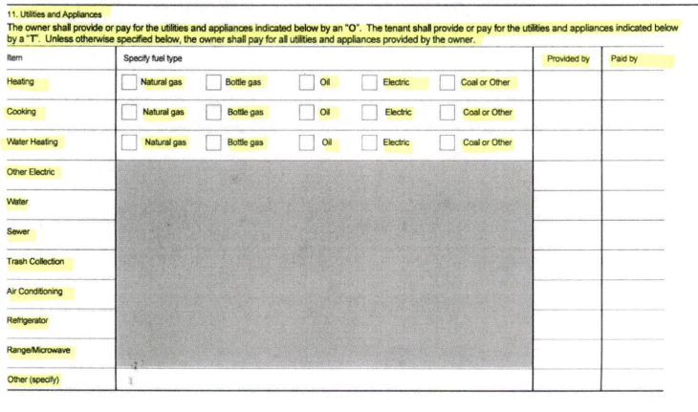
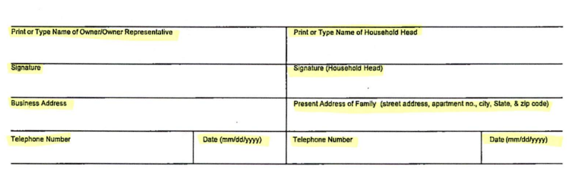
Notes:
Further down the page is information that CHA needs to know about what utilities will be paid by the owner and what utilities will be paid by the tenant. This must be correct as it will influence whether or not the rent and utilities will work with the payment standard and determines what the utility allowance is. Let’s start at the top. Heating, what utility is the heating source. Is it gas or electric. Very rarely do we see the other types of eating types of bottle gas, oil or coal. Please check the type of utility that fuels the heating appliance. In the next column we need to know who will be paying for or providing for that utility. For heating CHA needs to know who will be paying this utility. If the owner will pay, write in an O, if the tenant (you) will be paying write in a T. The same is for the cooking appliance. Is it gas or electric and will the owner or tenant be paying for the utility. Continue to the water heating. Need to know if it is gas or electric and if the owner or tenant will be paying. Other electric means the basic electric for the unit which includes your lights and electricity for your outlets etc. Who will be paying for this the owner or the tenant. Water Sewer and Trash – who will be paying for these utilities? If the unit has Air Conditioning, who will be paying the air condition, the owner or tenant. Range and Refrigerator. In most cases, the owner will provide the range and refrigerator so an O will need to be written under the “provided by” column for these two lines. CHA only wants to know if a microwave will be provided by the owner if a microwave is there in place of the range. Microwave’s can only replace the presence of a range if this is the case for all units in the same complex. Other can be used if a washing machine and /or dryer will be provided and who will be providing those appliances. The owner or the owner representative will then need to print, sign, indicate their business address, telephone number and the date. The tenant (you) will need to do the same. It is very important that CHA is provided reliable phone numbers in order for us to reach you or the owner in case we have questions. If the Request for Tenancy Approval is not completely filled out it will not be accepted and will delay the lease up process which will delay your rental assistance.

Slide 14
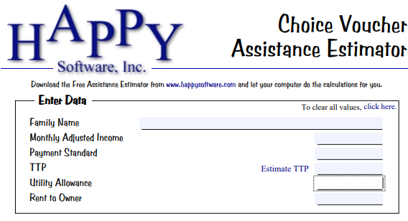


This is an ESTIMATE; the final number will be calculated when all required documentation is submitted.
NOTE: The family must pay the security deposit at the time of Lease-Up.
Notes:
This is an example of the estimate that will be provided to each family. It will provide you what the payment standard is that is based on the bedroom size and location of your Voucher. This will also give you an estimated amount of what your family contribution will be based on the information CHA has regarding your family composition, income and assets. This estimate is subject to change if the information CHA has changes. Please remember that the CHA does not assist with the security deposit and it will be the family’s responsibility to pay. You should start preparing to ensure that you have funds to pay the deposit at this time it is due.

Slide 15

The Approval Process of the Unit
1- When the family finds a suitable unit, the Landlord must complete the RFTA and both the family and the landlord must sign the RFTA and return it to the CHA.
2-The CHA will verify a variety of information on the RFTA:
- The unit is eligible based on income requirements
- The rent is reasonable
- Passed the housing Quality Standards Unit Inspection
Inspection Process:
1- The RFTA is submitted to the CHA
2- CHA will then contact the landlord to arrange for a (HQS) Section 8
inspection. to make sure that the unit meets the minimum Housing
Quality Standard.
3- If the inspection fails, the Landlord has 30 days to rectify the problem
and reschedule for a second inspection.
4 – A Good Place to Live (reference in your packet)
3- The family may be required to provide updated financial documents if the already submitted documents no longer meet the Hud required timeframes.
Notes:
The Approval process of the Unit. When you find a suitable unit that you would like to lease and the landlord is willing to work with the program, you and the landlord will need to complete the Request for Tenancy Approval form that we previously reviewed and submit as soon as possible to the CHA office. There is a variety of information that the CHA will review when the RFTA is received. CHA needs to ensure that the rent and utilities will work with the Voucher and that the rent is reasonable. This means that the landlord cannot charge you more rent just because you receive Voucher rental assistance. The landlord must charge you the same rent as they do a market rent for the same type of unit. Once the Request for Tenant is determined to work with the program, then CHA will arrange to have the unit inspected to make sure it meets Housing Quality Standards or HQS. If the unit passes inspection, we will proceed to the next step. If the unit does not pass inspection, the landlord has up to 30 days to rectify the problem and pass a second inspection. The sooner the unit passes inspection, the sooner rental assistance can begin. In your packet is a booklet called “A Good Place to Live” which provides for the general requirements a unit must meet to pass inspection. CHA is inspecting the unit to ensure it meets basic housing quality standards. Does it have adequate heat source, hot water, no broken windows, doors that lock etc.

Slide 16


4- At this point CHA will run the fingerprints for all adults (18+) in the HH:
If you have brought your picture ID, please stay after this meeting and we will get that done for you so that you do not have to come in later for that purpose alone.
HUD has strict guidelines of eligibility to maintain a safe housing environment. Household members will be denied if they are currently (within 6 months) or within the past 3 years, engaged in, or has engaged in any of the following criminal activities:
- Drug-related criminal activity
- Violent criminal activity
- Criminal activity that may threaten the health, safety, or welfare of other tenants
- Criminal activity that may threaten the health or safety of CHA staff, contractors, subcontractors, or agents
- Criminal sexual conduct, including but not limited to sexual assault, incest, open and gross lewdness, or child abuse
Notes:
After the group presentation is over, CHA will run electronic fingerprints for all adults who are 18 years of age and older in the household. This will be done if your have brought your picture ID. Household members who have a history of drug related or violent criminal activity within the past 3 years will be denied housing assistance. If you are denied housing assistance due to criminal history, you will have a chance to request an informal review of the situation and present any extenuating circumstances and/or provide information showing that you have completed what the courts have required such as drug rehabilitation or similar type of documentation. HUD does mandate that anyone required to register as a lifetime registered sex offender is not eligible to receive housing assistance.

Slide 17


5- If the CHA is able to approve all of the above, the CHA will notify the family and the owner. The family will receive a Household Certification indicating the actual Total Tenant Payment the family is responsible to pay.
6- The CHA will create a Housing Assistance Payment (HAP) contract to be signed by the owner. The owner must sign and return two copies.
7- CHA will start payments when all documents are signed and submitted.
Notes:
Once the CHA has verified that the rent and utilities will work with your Voucher, inspected the unit to show it meets Housing Quality Standards and all household members have passed the criminal background check, you will be provided a Household Certification that shows the final calculation of your family’s income and who will be living in the unit. It is mandatory that you inform the CHA of any changes in your income and/or household composition between the time your Voucher is issued and a Housing Assistance Payments contract is signed on your behalf. This is to determine the accurate amount of your housing assistance payment. Failure to notify the CHA of any changes during this time may result in you being required to repay CHA any overpayment of housing assistance and could possibly lead to the termination of housing assistance and not being eligible for housing assistance in the future. The Household Certification will show the Total Tenant Payment which is what the family will contribute to the rent and utilities. CHA will then create a Housing Assistance Payments (HAP) contract to be signed by the landlord. Once all of the documents are signed and submitted to CHA, housing assistance payments will be sent to your landlord on your behalf.

Slide 18


What we Learned
You can use your voucher at your current residence or look for a new place to live. (Do not let the voucher expire!)
Look for a unit that meets your needs and the rental price range estimate based on the HAPPY estimate provided.
Review the Landlord list provided in your Voucher packet as well as Tips for your Housing Search.
When you have found a unit, you and the Landlord will complete the RFTA (Lead Based Paint document - if required) to be returned to us.
The CHA will go over eligibility requirements for the final stages of the approval process to provide the family with housing assistance.
Your housing assistance payments will be released to the landlord only when all of the required paperwork is signed and submitted.
Security deposit is the responsibility of the family and must be paid according to your landlord’s requirements.
Notes:
This is an overview of some of what we have learned today about the Voucher program.
It is possible for you to use your Voucher where you currently rent – you might not need to move.
If you do need to search for a unit to use with your Voucher – ask prospective landlords what the rent is and what utilities you as the tenant will be responsible for paying and use the estimate provided to you to help you decide if the rent and utilities are in an acceptable range.
In your packet is a Landlord List and tips for your Housing Search. The Landlord List is a list of landlords/owners who have indicated they are willing to work with the Voucher program. They may or may not have units available. It is important that you start your search right away as the there may be a limited amount of units available for rent so you want to start looking now.
When you have located a unit that you want to lease and the landlord has agreed, complete the Request for Tenant Approval with the landlord as soon as possible and submit to the CHA office. This is the document that will trigger an inspection of the unit and start your housing assistance if it meets program requirements.
Housing assistance payments will only be released to the landlord once CHA has all of the required documents signed and received by our office.
The security deposit is the family’s responsibility. CHA does not assist with security deposits.

Slide 19


Family Obligations After Move-In (1)
For Successful Tenancy:
  Tenant / Landlord -> Lease
  Tenant / Authority -> Housing Agencies Policies and Procedures
General Requirements:
  Once you are leased up, you will be required to reside in the unit for one (1) year before you can move again.
  If you vacate the unit before the year is up your assistance will be terminated unfavorably, and you may not be able to successfully reapply to the program.
  If you wish to move to another unit after the first year, you will need to let your caseworker know and they will direct you on the proper procedures for a unit transfer.
  You will be required to certify every year. Your caseworker will mail out a recertification packet for you to complete. Failure to recertify within the provided timeframes will result in unfavorable termination.
Notes:
In order to receive Voucher housing assistance there are family obligations you must comply with. Once you have leased up under the Voucher program, you are required to live in the unit for one year. This means you cannot move for one year. When looking for a unit to lease, make sure that it is a place you want to live for an entire year. If three months into the year, you call the CHA office and state that you don’t like your neighbors because they keep you up all night and unit you rented is really too small, we will sympathize with you but you still cannot move until year lease is up. If after the year’s lease is up and you want to move, you can move with your Voucher assistance with thirty days written notice to the owner and the CHA office. Your CHA case worker will provide you the proper procedures to move if you decide this is what you want to do. If you move from your unit before the year is up, your housing assistance will be terminated unfavorably which can prohibit you from receiving housing assistance again in the future from any housing authority. Recertification, in order to continue to receive housing assistance you must recertify every year. Approximately 90 days or three months before your anniversary you will receive notice that you must recertify with our office. This is mandatory and failure to do so will result in the loss of housing assistance.

Slide 20

Family Obligations after Move-In (2)
Some major violations:
  Failure to supply any information that the CHA or HUD determines to be necessary
  Unreported family absences from the unit
  Failure to notify owner and CHA (30-day written notice) before moving out of the unit or terminating the Lease
  Failure to request PHA’s written approval to add any family member as an occupant to the unit
  Criminal activity / drug related criminal activity
  Failure to keep up with utilities and tenant portion of rent
  Damage the unit or premises and or permit any guests to damage the unit or premises
  Failure to follow CHA policies and procedures
  Failure to comply with the provisions of the Lease
  Mandatory Terminations:
  - Methamphetamine Manufacture or production
  - Lifetime Registered Sex Offenders
Notes:
Other major program violations that could result in the loss of housing assistance are:
Failure to supply any information the CHA or HUD determines to be necessary, unreported family absences from the unit, failure to request CHA written approval to add any family member as an occupant to the unit. The only people who can live with you are the people you listed in your household composition. If you want to allow someone to move into your unit, you must first receive written approval from your landlord and the housing authority before this person or persons move in. Allowing other people to live or stay with you that have not been approved by your landlord and the housing authority first is a serious violation of program rules. Engaging in violent criminal or any drug related activity, failure to pay your utilities and your portion of the rent, damages to the unit or any of your guests damaging the unit, failure to follow CHA policies and procedures and failure to comply with the provisions of your lease. Mandatory termination of the program including any methamphetamine manufacturing and if any household member is required to register as a lifetime registered sex offender.

Slide 21


Frequently asked questions
Q: What should I do if my income and/or who is living with me changes?
A: Any changes in Income and/or Household Composition (who is living with you) must be reported as soon as possible. The amount of your rent will be based on your family income and who is living with you, so it must be accurate at the time CHA starts assisting with your rent. If you do not report all changes, you will be required to repay any overpayment of housing assistance and could risk losing your Voucher.
Q: What should I do If I want to move?
A: Check to see when your lease expires and for renewal provisions.
The initial lease term is a minimum of one (1) year. A minimum of 30 days written notice from the first of the month is always required.
Q: What should I do when someone moves out of my home?
A: Promptly notify the Cheyenne Housing Authority in writing if any family member(s) no longer lives in the unit. Documentation of the former member’s new residence may be required.
Notes:
If you have any changes in your family income and/or who is living with you, you must report these changes as soon as possible. The amount of your rent will be based on your family income and who is living with you, so it must be accurate at the time CHA starts assisting with your rent. If you do not report all changes, you will be required to repay any overpayment of housing assistance and could risk losing your Voucher. What if you want to move once you start receiving housing assistance? One of the most common reasons, participants lose their voucher is because they move prior to receiving permission from the CHA before moving. Do not move out of your assisted unit before receiving permission from a CHA representative which will involve the processing of a new inspection, lease and other paperwork. Program regulations require that you live in your unit for one year before moving. After one year, typically you can move with a 30-day written notice to CHA and your landlord. CHA requires that lease rescission notice be signed by both parties. Another question is what if an approved household member moves out of your home? You have 10 days to report this information to the CHA office.

Slide 22
Frequently Asked Questions
Q: May I move into the unit as soon as I find one?
A: The Cheyenne Housing Authority cannot tell you and the owner what date you may move in. But we can tell you when we will begin the contract (ie. payments on your behalf). We will begin the contract and payment on the first day the unit passes inspection unless you and the owner agree to a later date). If the unit has not passed this agency’s inspection and you have moved into the unit, you are responsible for that rent.
Q: What happens if I cannot pay rent?
A: Always pay your rent. As much as we would like to end on that note, we realize there are times when situations may prevent you from complying. The decision as to what happens depends on the owner. Some owners choose to evict immediately. Contact your landlord and resolve the problem. Serious and/or repeated violations of the lease such as eviction for non-payment of rent or utilities that are shut off, or damage to unit beyond normal wear and tear can result in termination of the assistance.
Q: What should I do If someone wants to move in with me?
A: You must request approval to add any member to the family. The Cheyenne Housing Authority and the owner must give you permission before anyone moves into your unit. Promptly notify the Cheyenne Housing Authority in writing of the birth, adoption or court-awarded custody of a child.
Notes:
Some other questions you may have are:
1. Can I move into a unit as soon as I find one? This is up to you. However, if for some reason the Voucher does not work with the unit for example the rent is too high to work with the Voucher or it does not pass inspection, then you could be liable for the rent on your own if you sign a lease with the landlord. It is suggested that you wait to move into to ensure the Voucher will work with the unit before committing to a lease. What happens if I cannot pay my share of the rent? Your share of the rent is based on your income, so you should always be able to pay your share of the rent and it is important that you do so by the date indicated in your lease every. The landlord may charge a late fee if you do not pay your share of the rent on time and could terminate the lease which can result in the loss of housing assistance. It is important that your read and are familiar with the terms of your lease with the landlord and that you follow them. The lease with your landlord is a legal contract. Be sure you do not allow anyone to move in with you or stay with you without first obtaining written permission from your landlord and the housing authority before they move in. Ultimately, it is your responsibility to ensure that you comply with all Voucher program regulations. If you are not sure and have questions about what your responsibilities are, please reach out to the housing authority and we will assist you with your questions and/or concerns.

Slide 23


Questions?
This Photo by Unknown author is licensed under CC BY-SA.
Notes:
The Cheyenne Housing Authority wants you to be successful using your Voucher and supports your continued success throughout your tenancy. It is important to communicate with the housing authority office when ever you have questions or concerns and we will be happy to assist you when we can. Please do not hesitate to bring your questions or concerns up to a staff member.

Slide 24

Thank you for attending today’s session.
Resources:
  https://www.cheyennehousing.org
  - Briefing Packet
  - Briefing Video
  https://sitemanager.rentcafe.com/sitemanager/login.aspx
  CHA Housing Specialist: 307-633-8333
Notes:
Thank you for attending today’s session. Remember there are lots of resources to help you successfully use your Voucher online at cheyennehousing.org. This includes a full briefing packet, the briefing video and other information that may be helpful. Please stay after this group presentation to talk with a staff member to obtain your electronic fingerprints and talk specifically with you about your Voucher’s payment standard and an estimated amount of rent you are expected to pay based on the information you have provided.

