Slide 1
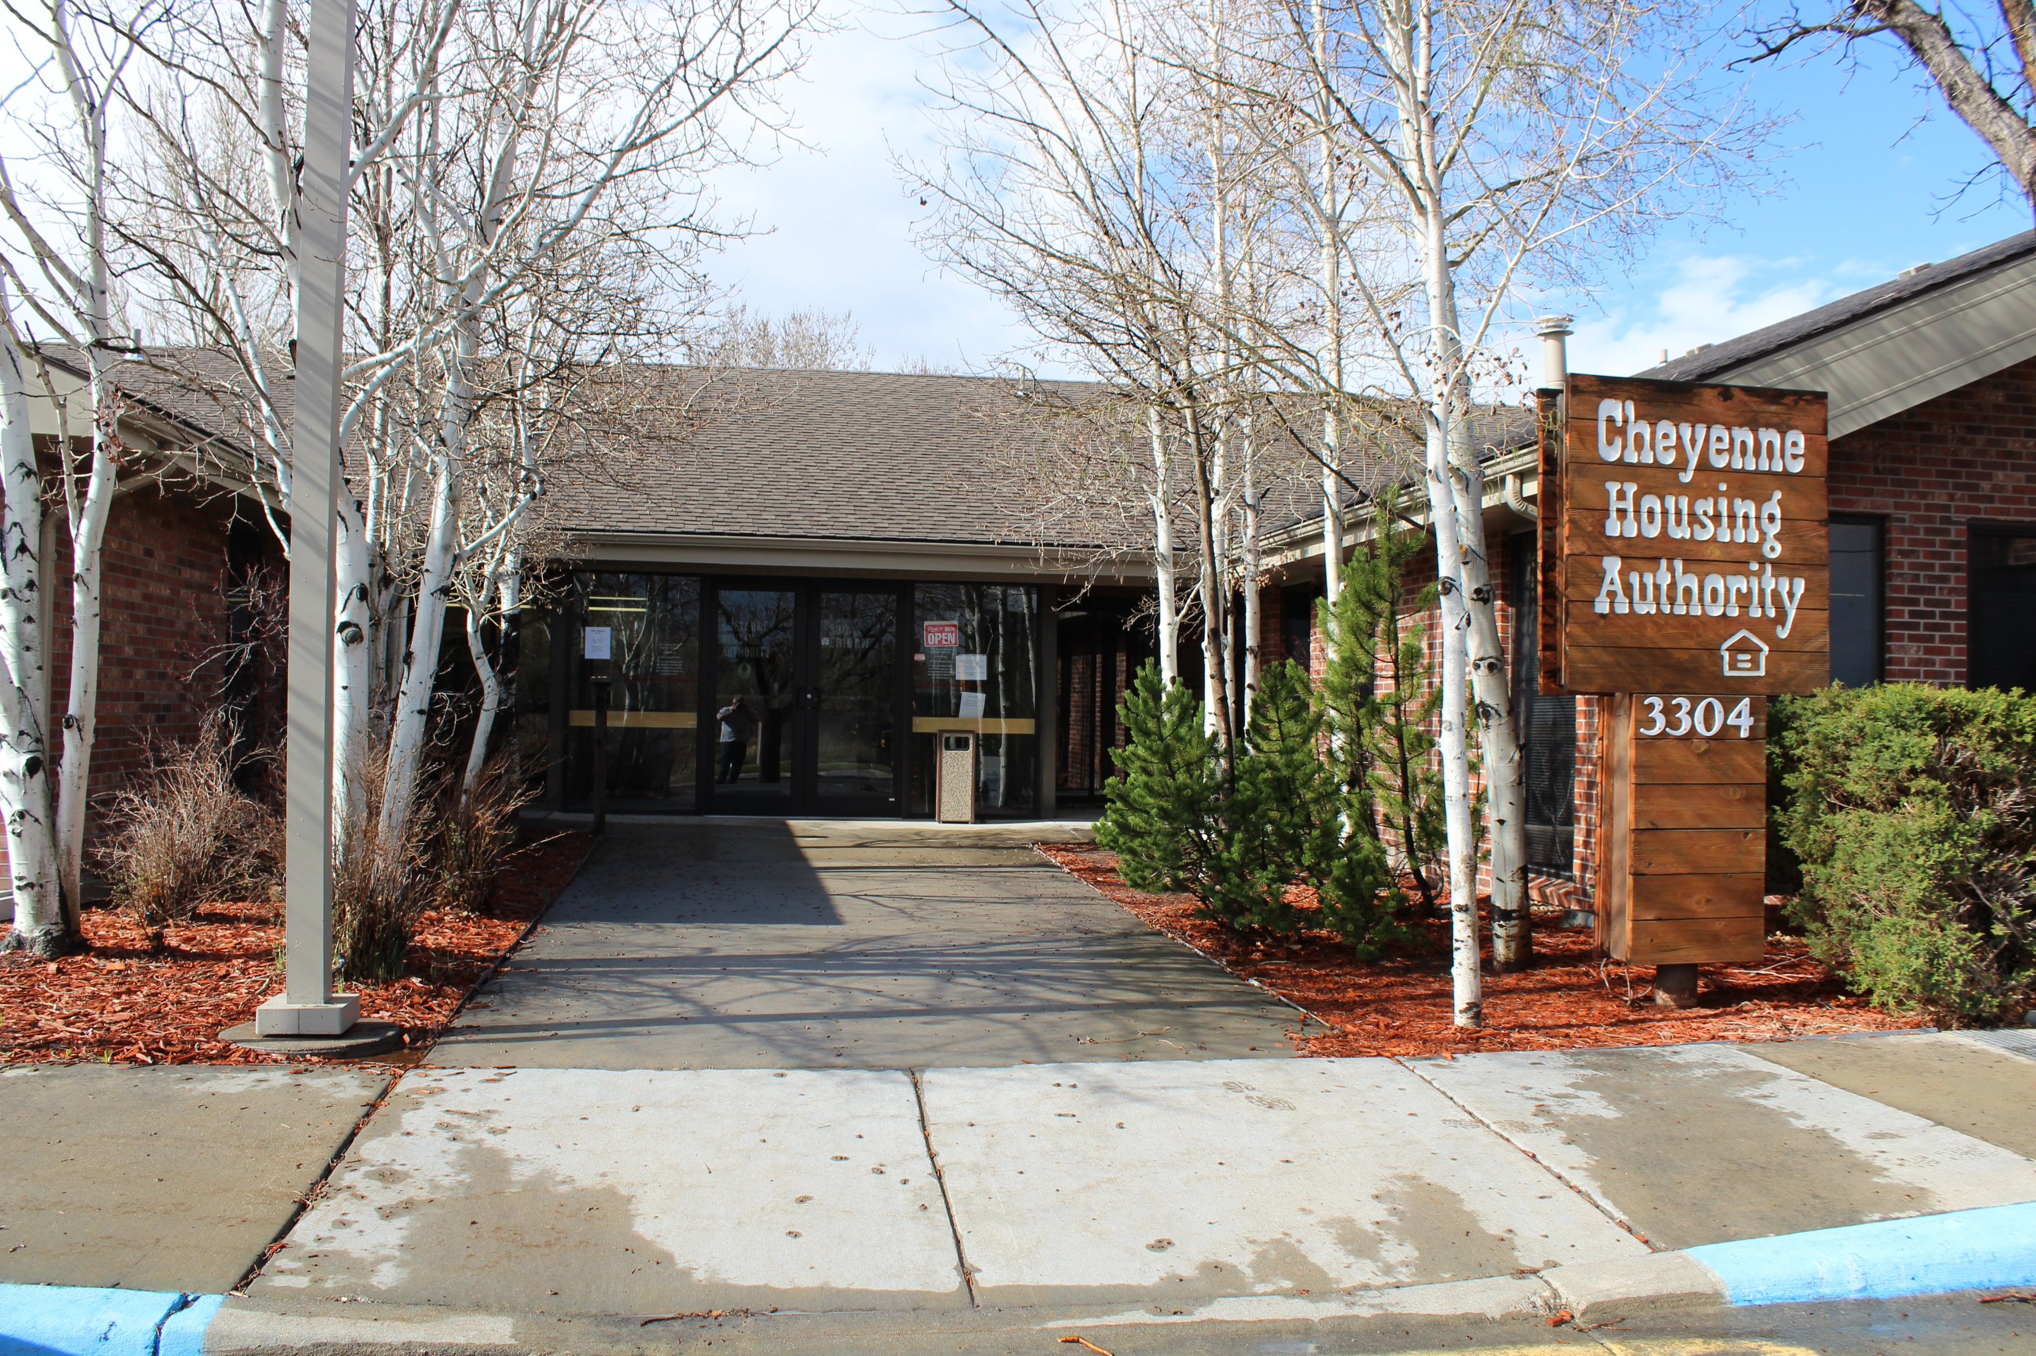
CHA Landlord Meeting
October 2025

Slide 2
The Cheyenne Housing Authority (CHA)
appreciates your partnership
in the Housing Choice Voucher (HCV) program.
Please add to the chat box:
Your Name
Properties you own / manage

Slide 3
Our Mission is to provide decent, safe, and sanitary housing to elderly, disabled, and economically disadvantaged families unable to obtain housing through conventional means.

Slide 4
We have several housing programs:
Housing Choice Vouchers
  1806 HCV monthly vouchers
  158 VASH monthly vouchers
Public Housing
  341 units in Cheyenne & Laramie
Non-HUD Housing
  208 units in Cheyenne
Notes:
Share that we have experience in being a Landlord, collecting rent, dealing with damaged units and problem tenants. We feel your pain!
The HCV Program is designed for CHA to work directly with landlords, (large and small)in our community. That’s what we have focused our presentation on.

Slide 5

Jurisdictional
Intake Agents /Inspectors:
Michelle in Sheridan
Jan in
Buffalo
Sherrie in
Gillette
Susan in Cody &
Powell
Angela in Riverton & Lander
Al in Cheyenne
Mike in Rawlins
Kaylee in Laramie
This Photo by Unknown Author is licensed under CC BY-SA
Notes:
Reminder all requests for inspections must come through CHA.

Slide 6
Today’s Agenda:
Meeting Norms
CHA Partnership Incentive
Methods of Contact
Inspections
Housing Choice Voucher (HCV) Program Overview
Request for Tenancy Approval (RFTA) Document Completion
Final Documents at Lease Up
HCV Current Tenants
  Rent Increases
  Move Outs
Future Meetings

Slide 7
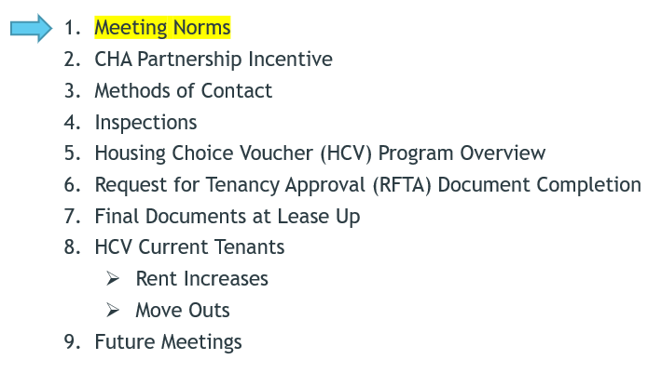
1. Meeting Norms:
We are here to share, learn, and collaborate - with positive Intent
Questions are essential for all of us – please list them in the chat
Please stick to general questions. If you have tenant specific inquiries you can email us directly.
Your time is important – we will adhere to meeting time frames

Slide 8
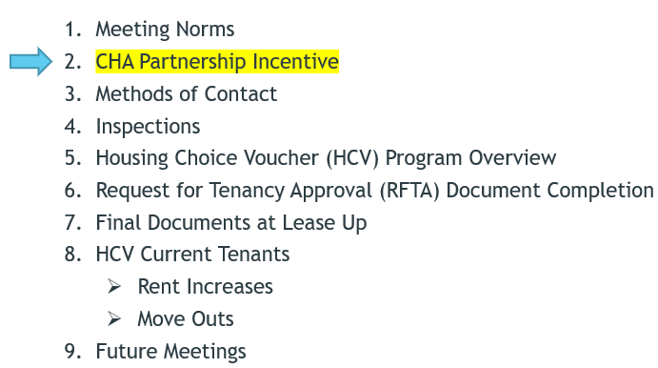
2. CHA Partnership Incentive Details:
In appreciation of this partnership, this Notice announces that between May 1st, 2025 and December 31st, 2025, CHA will pay up a $500 lease-up incentive to any owner/property manager that successfully leases a unit and executes a Housing Assistance Payments (HAP) contract with CHA during this period.
This applies only to new Voucher holders and does not apply to unit transfers for participants that already receive housing assistance.
The incentive payment will be sent when the first HAP payment is released - which is when all required documents are received and approved by CHA.
CHA reserves the right to discontinue this offer at any time for any reason.
If you have any questions please contact Amanda Allard at 307-633-8314.
The CHA has awarded 175 incentives so far in the last 6 months, totaling $87,500.00!

Slide 9
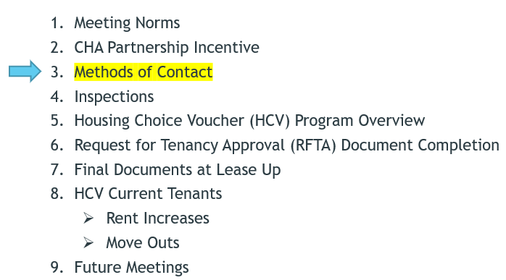
3. Methods of Contact:
Phone calls are good, fax is okay, but emails are better!
Please include the Head of Household (HoH) name in the subject line.
If you are including documents you can list HoH RFTA in the title for priority service.
Let us know if you need a secure email sent to you to return documents.
Let us know if you are interested in an e-signature option.
The CHA Landlord Portal allows access to upload documents directly to us.

Slide 10
3. Contact Information:
Housing Specialists for current Voucher tenants are assigned by the tenant’s last name:
  A – G: Jemini Hernandez; jhernandez@cheyennehousing.org ; 307-633-8301
  H – 0: Jenny Parsons; jparsons@cheyennehousing.org ; 307-633-8338
  P – Z: Nicole Stock; nstock@cheyennehousing.org ; 307-633-8336
The Eligibility team works with applicants throughout the process of receiving a Section 8 Voucher:
  Michelle Wheeler; mwheeler@cheyennehousing.org ; 307-633-8329
  Dana O’Dell; dodell@cheyennehousing.org ; 307-633-8337
  Kat Fiore; Kfiore@cheyennehousing.org ; 307-633-8331
  Eligibility@cheyennehousing.org
Accounting Landlord payments and Portal Assistance:
  Rochel Kirkbride; rkirkbride@cheyennehousing.org ; 307-633-8304
Housing Programs Director:
  Amanda Allard; aallard@cheyennehousing.org ; 307-633-8314

Slide 11

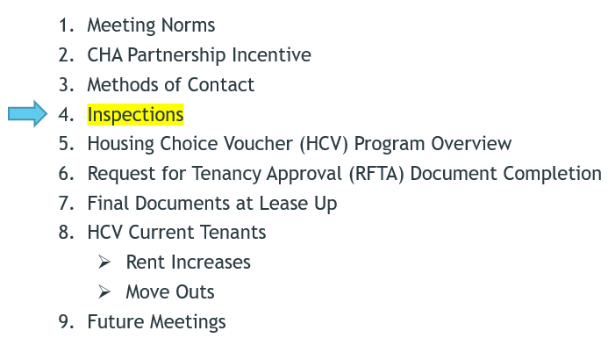
4. Inspections:
All housing units with HCV tenants must meet the following thirteen (13) HQS performance requirements both at commencement of assisted occupancy and throughout the assisted tenancy:
  Sanitary facilities
  Food preparation and refuse disposal
  Space and security
  Thermal environment
  Illumination and electricity
  Structure and materials
  Interior air quality
  Water supply
  Lead-based paint
  Access
  Site and neighborhood
  Sanitary conditions
  Smoke detectors & Carbon monoxide detectors
Are required prior to lease-up; scheduled by the CHA
Completed once every 2 years there after
https://www.cheyennehousing.org/wp-content/uploads/LL-A-Good-Place-to-Live.pdf

Slide 12
Smoke and Carbon Monoxide Detectors:
HUD now requires that all smoke detectors be hardwired OR contain a 10-year tamper resistant battery.
Each level of the unit (including basement) must have a smoke detector AND a detector in each sleeping room AND outside the common area of bedrooms.
Smoke detectors mounting on the ceiling should be more than 4 inches from the wall. If mounted on the wall, they should be between 4-12 inches from the ceiling.
Basement smoke detectors should be installed on the ceiling at the bottom of the stairs leading to the next level.
No detectors should be installed near (closer than 3 feet) windows, doors or vents.
For units serviced by any fuel-fired (gas, wood, oil, etc) appliances, they must have a carbon monoxide detectors installed within “the immediate area” of sleeping.
Carbon monoxide detectors must be installed in units with attached garage.

Slide 13
New Inspection Updates: NSPIRE
HUD is replacing the HQS inspections with the new National Standards for Physical Inspection of Real Estate requirements.
The implementation of these changes has been delayed until February 1, 2027.
  HOWEVER, there are things we want to start preparing our Landlords and Tenants for now.
These new standards prioritize the health and safety of the residents above all else and are higher expectations than the HCV program has been held to before.

Slide 14
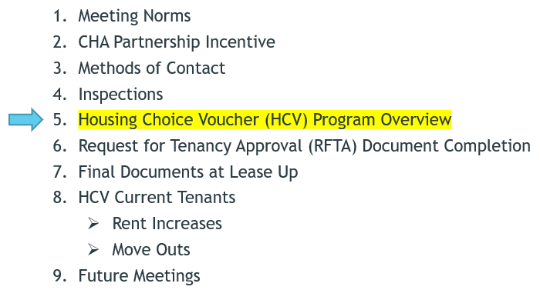
5. Housing Choice Voucher Program:
Federal government’s primary program for assisting very low-income households, elderly and disabled persons to afford decent, safe, and sanitary housing in the private market. Qualified households use vouchers to subsidize the rent they pay to landlords of privately owned properties.
A household issued a housing voucher is responsible to find a “suitable” housing unit of the family’s choice where the owner agrees to rent to the tenant under the program. Rental units must meet minimum health and safety standards defined by HUD and verified by the CHA.
A housing subsidy is paid directly to the landlord by the CHA on behalf of the participating household. The household then pays the difference between the actual rent charged by the landlord and the amount subsidized by the program.
Landlord
Housing Choice Voucher Program
Tenant
CHA
Notes:
Summarize: The HCV program is designed as 3-way partnership among the Landlord, Tenant, and CHA each benefitting from the others being involved.

Slide 15
Benefits of Housing Choice Voucher Program for Landlords:
You will get timely and dependable payments from CHA. Participating, compliant landlords will receive timely and dependable housing assistance payments (HAP) each month once the HAP contract and lease are signed.
You will get your full rental payment. When a HCV tenant’s income permanently changes, the portion of rent paid by the CHA and the tenant is adjusted to reflect this change. This provides financial protection to landlords in that if a HCV tenant’s income decreases, there is a process for the CHA to pay a larger portion of the rent to the landlord so the landlord continues to receive a full rental payment.
You will receive regular inspections. Some landlords appreciate the routine inspections because they provide an opportunity to check on the condition of the unit. This can result in identifying maintenance needs that may have otherwise gone unnoticed for some time.
You may request annual reasonable rent increases. Compliant landlords may request a rent increase at the annual anniversary of the HAP contract by written notice to the CHA.
You have the opportunity to help low-income elderly, disabled, and veteran households, as well as families with children by providing affordable housing. More than 50 percent of vouchers serve elderly or non-elderly disabled families. About 45 percent of vouchers assist single-parent families.

Slide 16
Housing Choice Voucher Myth-Busting:
“Landlords can’t charge HCV participants the same rent as their non-HCV tenants.”
  FALSE- Landlords can charge the full rent no matter who the tenant is. The housing authority must determine that the proposed rent is reasonable and is not higher than units in that area with similar amenities.
  NOTE: However, you may be asked to reduce the lease-up rent amount depending on the tenant’s income or rent reasonableness comparisons.
“It is almost impossible to evict a HCV tenant when they violate the lease.”
  FALSE- HCV tenants are bound by the terms of their rental agreements and are subject to eviction as is any non-HCV tenant.
“If you accept one HCV Program tenant, then all of your units must be rented to HCV Program tenants.”
  FALSE- Renting unit(s) to HCV tenants does not in itself further obligate you to rent to other HCV tenants. For each vacancy, you should follow your established policies for screening prospective tenants.

Slide 17
Tenant Information that CHA can share with Landlords:
CAN:
  If an applicant has an active Voucher and the effective dates of the Voucher
  The bedroom size of an active Voucher
  Anything the applicant specifically authorizes CHA to discuss
    Note: Such authorization must be in writing via a signed release form
CANNOT:
  Applicant’s income and asset information
  Disability status / medical / confidential personal information
  Status of applicant’s paperwork or missing items from applicant
  Applicant’s background check with CHA or rental history

Slide 18
The Eligibility Process Flow:
Pre-applications (online and paper packets)
Waiting List / Preferences
Time Frames
  Preference vs No Preference
Application Selection Process
Eligibility Packets and Review
Voucher Ready / Mandatory Group Informative Meeting
RFTA / Inspection / Lease with the Landlord
Final Documents Issued / Signed
HAP Payments
NOTE: Applicants DO NOT have to move units to be eligible for a voucher. They can receive Housing Assistance Payments for the unit they currently live-in IF it qualifies.

Slide 19
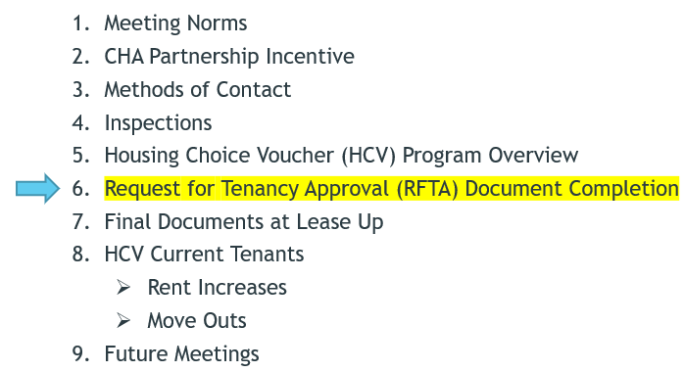
6. Request for Tenancy Approval (RFTA) document completion tips:
Make sure the appropriate property name and address are listed – including the unit number, city, state, and zip code
Year Constructed does have to be filled in
Don’t forget to fill out each area of the utilities and appliances responsibility form
  Note: The only columns that can have “N/A” are A/C and Other. All other columns must have a T for tenant or O for owner
Ensure you sign and date the document, and the tenant has to sign as well
We also need a signed copy of the lease before Housing Assistance Payments (HAP) can be released to you
  The rent amount and utility responsibility must match the RFTA and signed HAP
  The lease must be for a full calendar year, and have effective dates either match or are within 60 days prior to the HAP dates
    9/15/25 – 9/14/26 = Correct
    9/15/25 – 08/31/26 = Does not meet HUD requirements
Notes:
Other lease date examples.
HAP effective date 10/1/25 but lease effective 7/1/25 – will require a lease addendum extending dates.
HAP effective date 10/1/25 but lease effective 10/2/25 – will require a new HAP/HHC and change the date assistance begins.
HAP effective 10/1/25 but lease effective 9/1/25 – approved with no lease addendum.

Slide 20
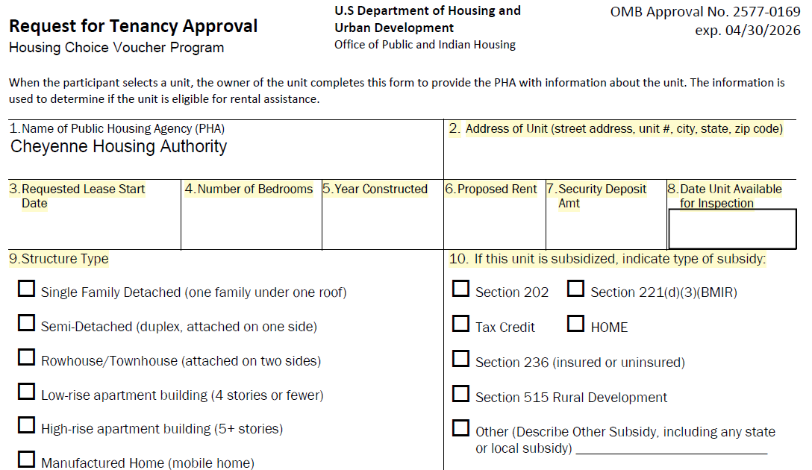
Before submitting the RFTA, be sure all fields are filled out completely and accurately.
Notes:
It is extremely important that the entire document is completely filled out. The first section needs to indicate the address of the unit including the city, state, and zip, when you would like the lease to begin (can be tentative), the number of actual bedrooms in the unit, the year it was built, the proposed rent, security deposit and when the unit will be available for inspection. The security deposit is the family’s responsibility pay in full as the CHA does not assist with security deposits.

Slide 21
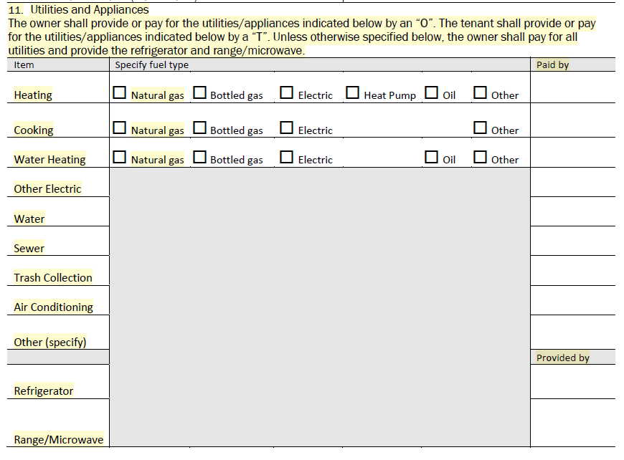
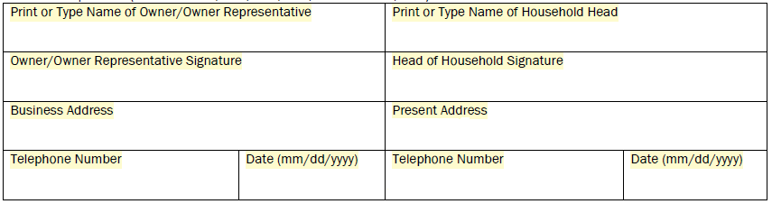
Note: “Other Electric” is for the lights, appliances, wall outlets, etc. used in the unit. This column cannot be listed as “N/A”
A/C is who pays for the electricity associated with the A/C, not who provides it

Slide 22
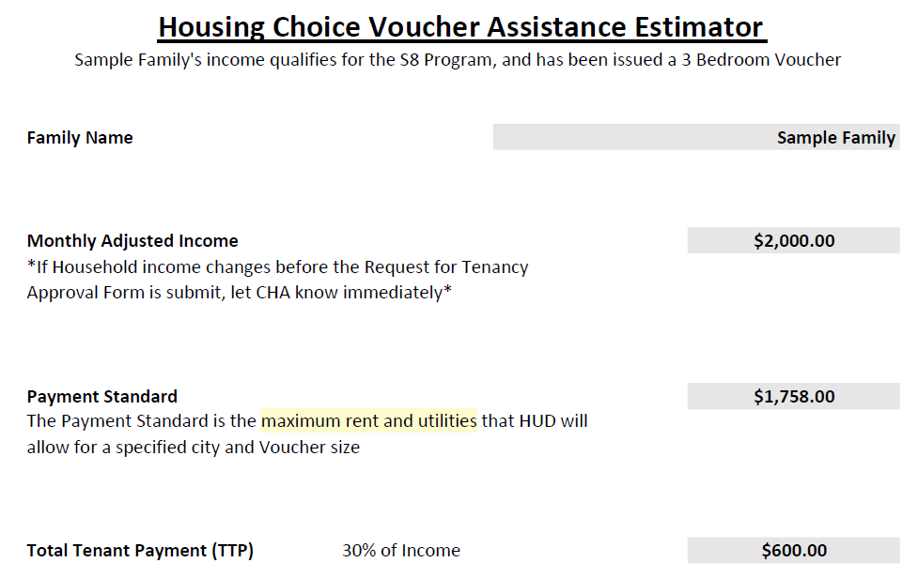
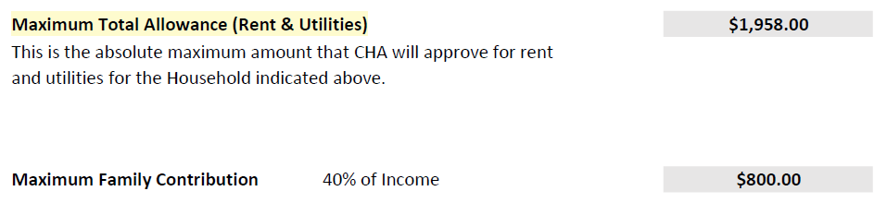
This is an ESTIMATE and subject to change; the final number will be calculated when all required documentation is submitted.
If a family has Zero Income, their maximum budget is equal to the payment standard.
Note: It is the family’s responsibility to pay for security deposits.
Notes:
Payment standards are based on HUD FMRs and are updated every year.
The applicant is not required to show you this document, it is meant for them to have a budget to work off of when looking for a unit to rent.

Slide 23
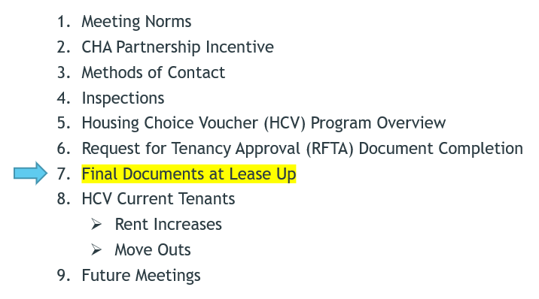
7. Final Documents After A Passing Inspection
“Final Documents” required to release payments include the following:
  Signed HAP contract
  Signed lease agreement with matching information that CHA has on file
  Signed Household Certification – signed by Tenant, not sent to Landlord without a release
  Any other documents CHA may be missing to complete the file
CHA typically sends the request for lease and the HAP / Household Certification via email to expedite the process, unless a mailed copy is requested.
Assistance Payments begin as of the date of a passing inspection or the tenant’s move in date, whichever is later. The date will show on the HAP contract.
If there is a change in a tenant’s move in date, please let CHA know as soon as possible so adjustments to the HAP contract can be made.
A tenant is not fully “approved” until all final documents are received, reviewed, and approved, and CHA countersigns the HAP contract. Payments are released at that time.

Slide 24
HAP Payments
After the final documents are all signed and turned in, CHA reviews to ensure nothing is missing, and that the lease is in compliance / matches HAP.
This process may take 1-2 business days, and then payment is released. CHA makes initial HAP payments on the 1st and 15th of the month. If the payment day lands on a holiday or weekend, it is pushed to the next business day.
  Example: If all final documents are turned in, reviewed and approved on 10/5/25, then the first HAP payments would be released on 10/15/25.
After the initial Lease Up process, HAP payments are paid on the 1st business day of each month.
  If you do not already receive payments via EFT, ask us to help you sign up!
No more documentation is needed until the Annual Recertification.

Slide 25
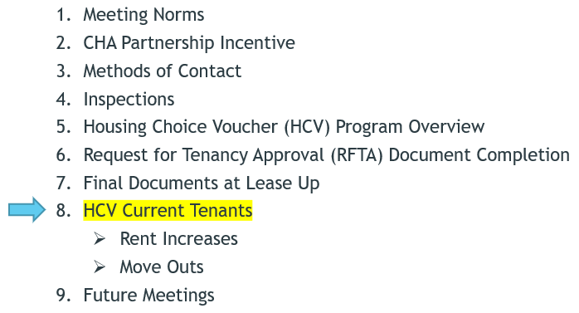
Existing HCV Tenants FAQs

Slide 26
Rent Increase Requests:
Annual requests to increase a tenant’s rent amount are permitted, effective the recertification date of the tenant with the HAP contract.
The CHA sends a notification to the Landlord 90 days in advance of the recertification date, allowing the Landlord 30 days to submit the rent increase.
All rent increases must be submitted in writing / e-mail / Landlord portal, within the required due date.
Rent increases are subject to rent reasonableness comparisons unless you are a Tax Credit property.
Any amount of rent and/order tenant paid utilities above the payment standard will be charged directly to the tenant. NOTE: After the first year of tenancy, the tenant’s portion of their rent to income ratio may exceed 40%.

Slide 27
Tenant Move-outs:
The CHA will notify Landlords as soon as we know a tenant has vacated an assisted unit and stop the housing assistance payment.
You must contact CHA as soon as you are informed or have knowledge a tenant has moved out of the assisted unit.
HUD does not allow the CHA to pay for storage. If the tenant has moved, but their items remain in the unit, CHA must stop the housing assistance payment the date the tenant stopped living in the assisted unit.
UNIT TRANSFERS – Do not transfer tenants receiving housing assistance payments to a different unit even if it is within the same property that you own or manage. CHA must authorize any unit transfer before the tenant moves. If the tenant moves prior to authorization by the CHA the landlord will be required to repay any housing assistance payments paid after the tenant moved out of the approved unit.

Slide 28
If you are required to return funds to the CHA for an overpayment of HAPS, you can select:
Submit a check to the CHA
OR
Choose to have the amount deducted from other HAPs at the next monthly disbursement.
Please contact Rochel to confirm which option you choose.
Rochel Kirkbride; rkirkbride@cheyennehousing.org ; 307-633-8304

Slide 29
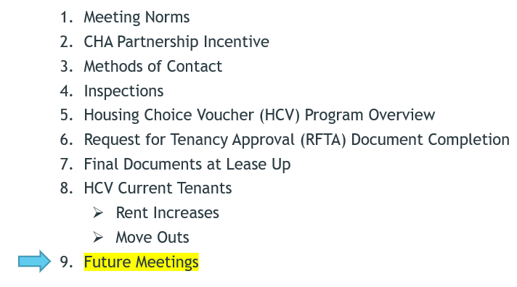
9. Future Meetings:
Frequency
Best Day and Time Availability
Topic Suggestions:
  Landlord – Owner Online Portal
  VAWA
  Reasonable Accommodations
Tell Your Landlord Friends

Slide 30
How We Can Help You!
Answer questions
Add you to our Landlord list
Post your flyers on our Bulletin Board
  Let us know if you have vacancies!
Landlord Portal has a lot of good information

Slide 31
Any Questions?
Cheyenne Housing Authority thanks you for your participation today!

