Slide 1
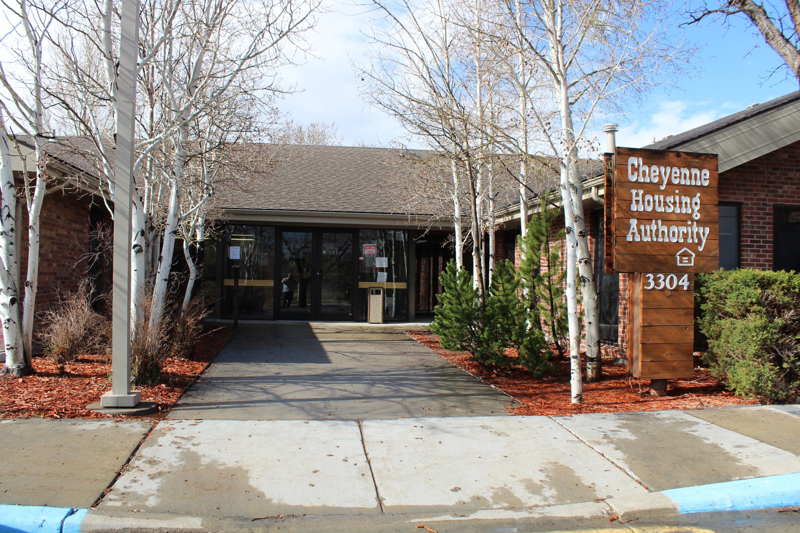
CHA Landlord Meeting
January 28, 2026

Slide 2
Our Mission is to provide decent, safe, and sanitary housing to elderly, disabled, and economically disadvantaged families unable to obtain housing through conventional means.

Slide 3
The Cheyenne Housing Authority (CHA)
appreciates your partnership
in the Housing Choice Voucher (HCV) program.
Please add to the chat box:
Your Name
Properties you own / manage
Any future topics you would like us to discuss

Slide 4
Today’s Agenda:
Meeting Norms and Methods of Contact
Landlord Portal
Registering and Tips / Tricks
Landlord Rent Increases
Reasonable Accommodations
Request for Tenancy Approval (RFTA) to End of Process
Backgrounds and Program Disqualification
HUD’s Optional Contact Form 92006 and CHA’s Authorization for Release of Information (AROI)
50058 copies to tenants only
Questions and Suggestions

Slide 5
1. Meeting Norms:
We are here to share, learn, and collaborate - with positive Intent
Questions are essential for all of us – please list them in the chat
Please stick to general questions. If you have tenant specific inquiries you can email us directly.
Your time is important – we will adhere to meeting time frames

Slide 6
1. Methods of Contact:
Phone calls are good, fax is okay, but emails are better!
Please include the Head of Household (HoH) name in the subject line.
If you are including documents you can list HoH RFTA in the title for priority service.
Let us know if you need a secure email sent to you to return documents.
Let us know if you are interested in an e-signature option.
The CHA Landlord Portal allows access to upload documents directly to us.

Slide 7
1. Contact Information:
Housing Specialists for current Voucher tenants are assigned by the tenant’s last name:
A – G: Cassie Baum; cbaum@cheyennehousing.org ; 307-633-8301
H – 0: Wendy Renteria; wrenteria@cheyennehousing.org ; 307-633-8322
P – Z: Nicole Stock; nstock@cheyennehousing.org ; 307-633-8336
The Eligibility team works with applicants throughout the process of receiving a Section 8 Voucher:
Michelle Wheeler; mwheeler@cheyennehousing.org ; 307-633-8329
Dana O’Dell; dodell@cheyennehousing.org ; 307-633-8337
Kat Fiore; kfiore@cheyennehousing.org ; 307-633-8331
Eligibility@cheyennehousing.org
Accounting Landlord payments and Landlord Portal Assistance:
Rochel Kirkbride; rkirkbride@cheyennehousing.org ; 307-633-8304
Housing Programs Director:
Amanda Allard; aallard@cheyennehousing.org ; 307-633-8314

Slide 8
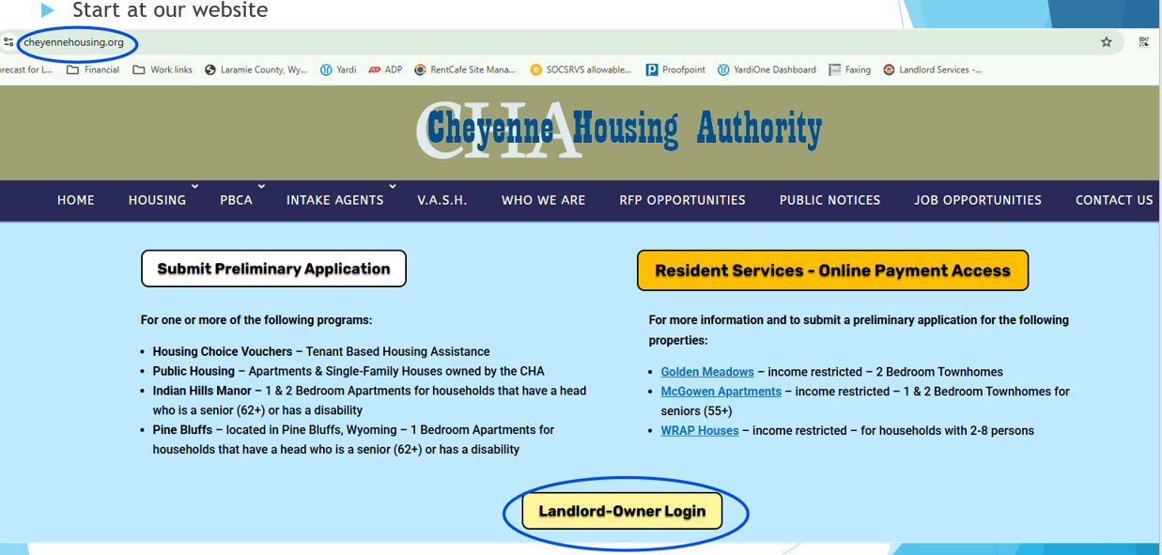
2. Landlord Online Portal:

Slide 9
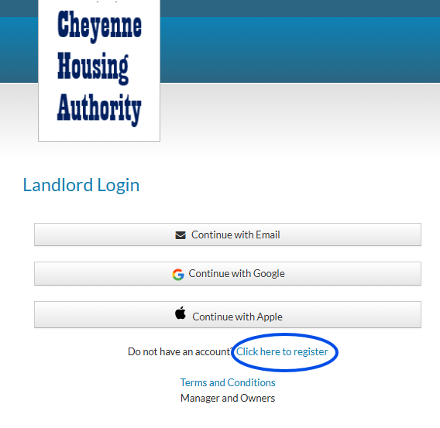
Important tips about Registering:
You will need a one-time code that is provided by CHA.
You will need to use the same email to register that is on file for your property at CHA. If you use Yardi software, you will need to add “+cha” to your email.
You will be asked for your property’s tax identification code, so have that handy
Only one account is allowed per property, so consider that if you will be sharing the login information (password) with others.
***Email Rkirkbride@cheyennehousing.org for your registration code***

Slide 10
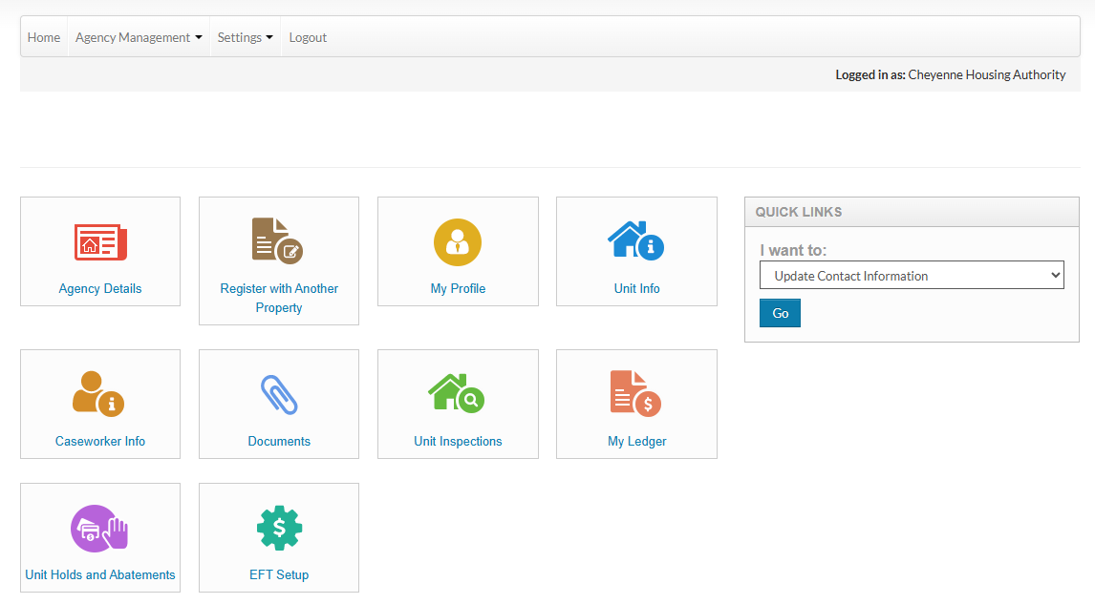

Slide 11
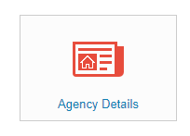
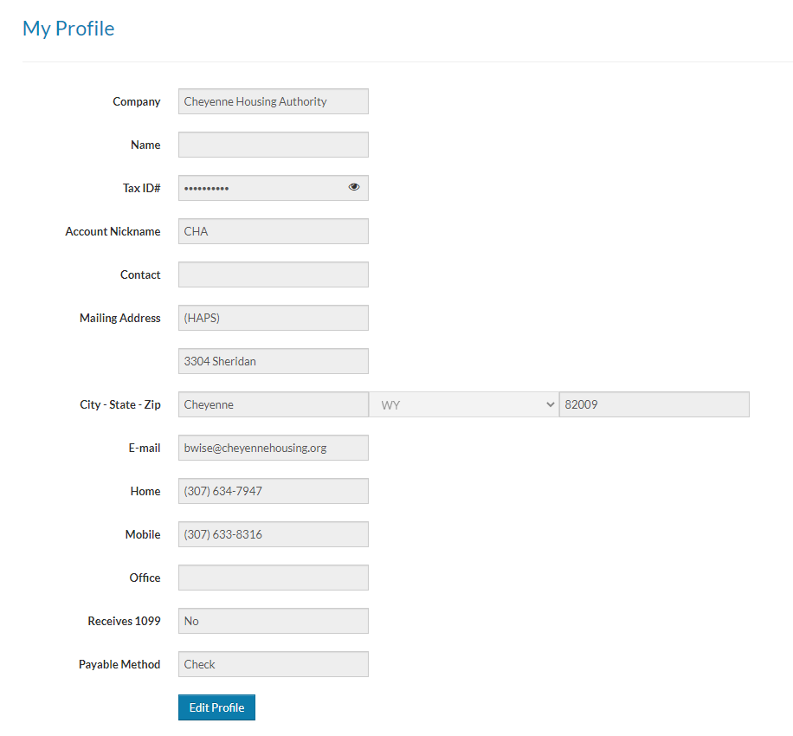
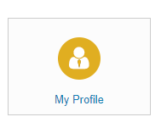
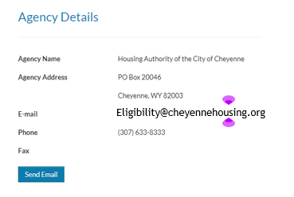
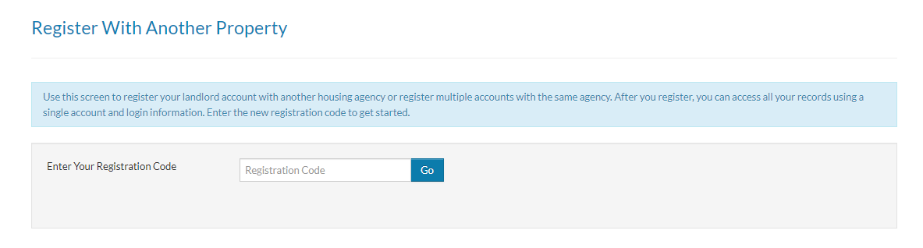
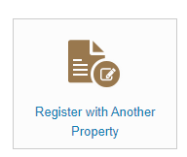

Slide 12
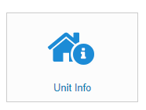
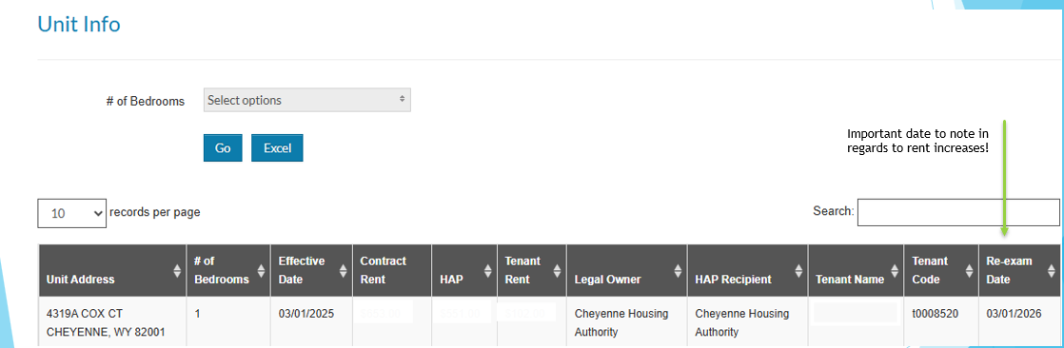

Slide 13
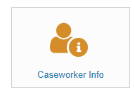
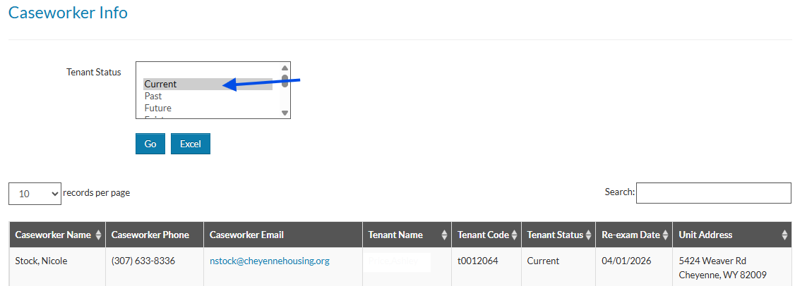
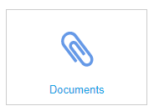
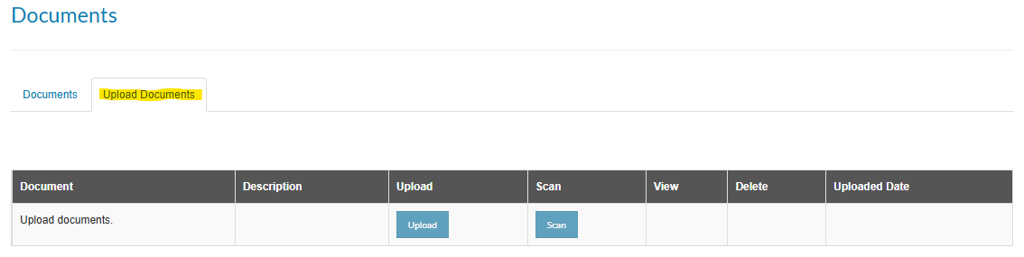
**No need to choose a specific email – it will upload where it needs to go!**

Slide 14
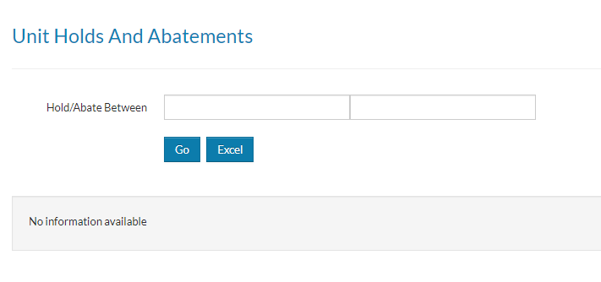
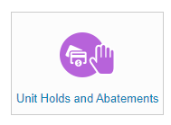
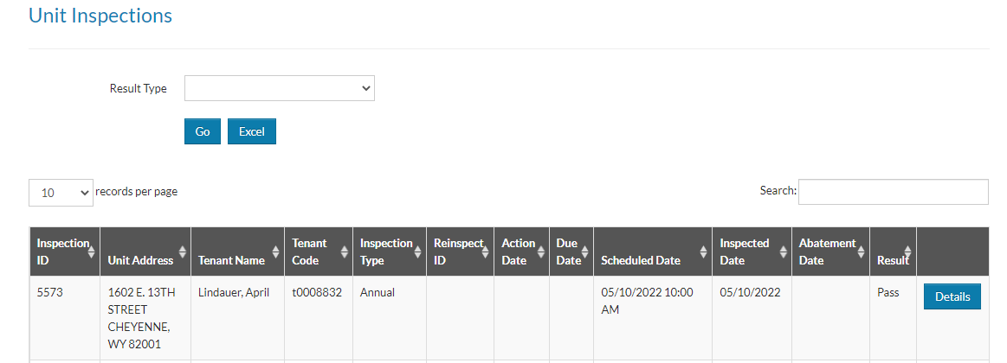
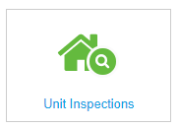

Slide 15
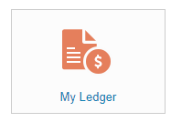
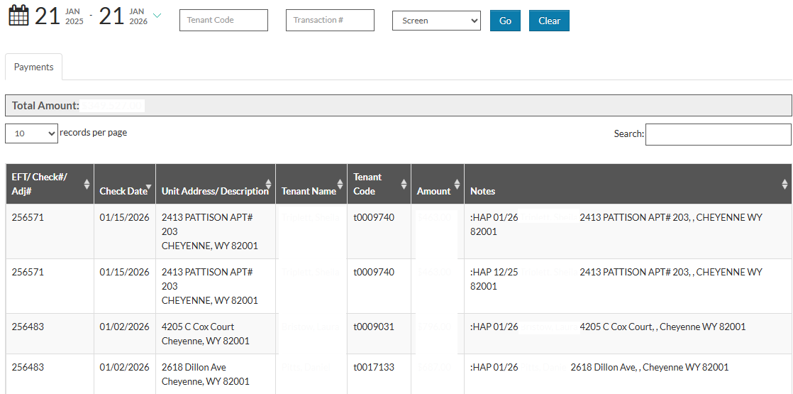
Can upload to excel using this drop down

Slide 16

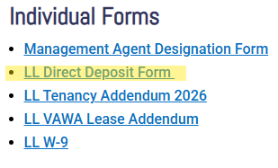
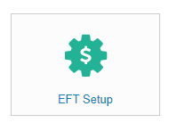
If you have not signed up for payments via Electronic Funds Transfer (EFT),
we HIGHLY RECOMMEND that you do!
Email rkirkbride@cheyennehousing.org for a form,
Or visit our website and click the following link:
Please do not use the EFT Setup tile in RentCafé. It will not be as efficient.

Slide 17

USE THE LANDLORD PORTAL
EMAIL: Rkirkbride@CheyenneHousing.org

Slide 18
2. Landlord Rent Increase Policy:
Rent Increases can be requested once every 12 months. The first rent increase may be requested at the end of the initial lease term for each individual unit.
Owners may submit a request to the Cheyenne Housing Authority for any changes in the amount of rent, at least sixty (60) days prior to the annual recertification date of the respective participant.
All rent increases must meet rent reasonableness, as required by HUD.
Rent Reasonableness:
In making rent reasonableness determination, the Housing Authority will compare the rent for the unit to the rent of comparable units in the same or comparable neighborhoods.
The Housing Authority will consider the location, quality, size, number of bedrooms, age, amenities, housing services, maintenance and utilities of the unit and the comparable unit.
The Owner must certify the rents charged for other units.
By accepting the housing assistance payments each month the owner is certifying that the rent to the owner is not more than the rent charged by the owner for other comparable units in the premises.

Slide 19
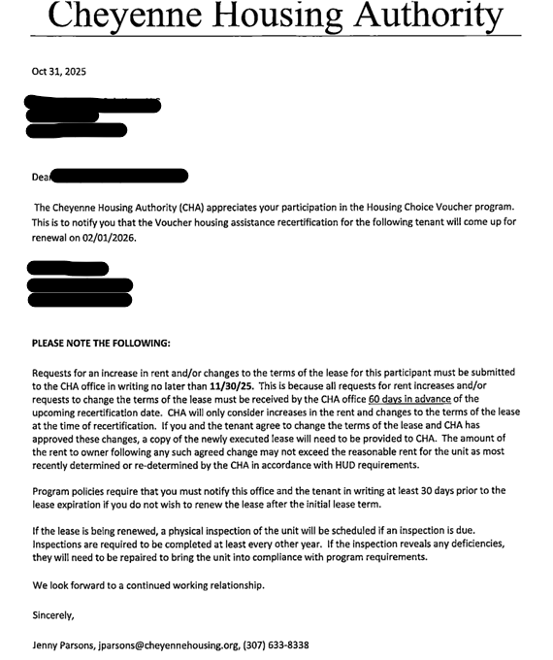
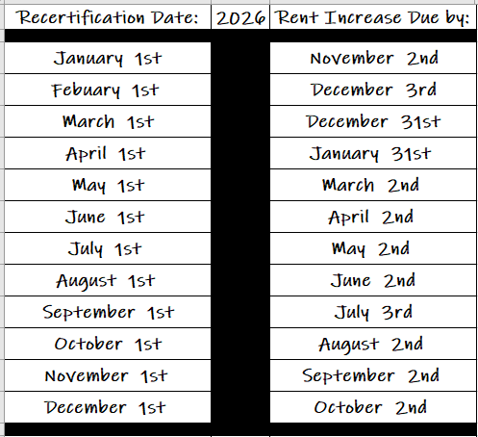
2. Landlord Rent Increases – Due Dates:
The CHA sent the tenant rectification and the notice to the Landlord for rent increases 3 months prior to the recertification date, providing each party 30 days to submit documents:
Late requests for increases in rent cannot be approved.

Slide 20
2. Landlord Rent Increases –Submission Options:
Landlord portal – Preferred method
Email (all current HCV specialists)
Fax (307-633-8315)
Mail to: PO Box 20046, Cheyenne, WY 82003

Slide 21
3. Reasonable Accommodations:
Reasonable accommodations are changes, exceptions, or adjustments to a program, service, or procedure that allow a person with a disability to have equal enjoyment of the housing program.
Mandated by HUD, verified through CHA, for individuals who meet requirements for a disability related need.
May impact HAP contract out of necessity for HUD requirements.
What the CHA can communicate to you.

Slide 22
4. Request for Tenancy Approval (RFTA) to End of Process:
When the RFTA is Received:
We confirm the rent amount works with the Voucher program requirements which includes evaluating the tenant's income to ensure there is sufficient to cover any rent/utility amounts that may be over the payment standard.
The CHA runs a criminal background check on all adults in the household and have the file audited PRIOR TO scheduling an inspection.
If there are any issues when the FBI processes the fingerprints it can result in a delay to the process or denial.
Once we have a passing background, we schedule an inspection.

Slide 23
4. Request for Tenancy Approval (RFTA) to End of Process:
Once we issue final documents, we must receive:
An Approved Lease - matches unit, household members, rent amount, utilities, and HAP dates
Signed Housing Assistance Payment (HAP) Contract
Signed Household Certification (HHC) – Please note: we cannot accept the TIC in place of the HHC
*Tenant Specific* - Utility Reimbursement Documents and a copy of their Utility Bill
If a tenant notifies us of ANY changes throughout this process (adding a person, change of income, etc.), we have to process those changes. Even if we have a passing inspection, we may not be able to issue final documents.
Unless we have a 92006 or AROI on file for you (the Landlord), we cannot disclose what is holding up the file; it is the tenant’s responsibility to keep you informed.

Slide 24

4. Backgrounds & Program Disqualifications:
Criminal Background checks are required for all adults in the household.
Before a voucher is issued:
National Sex Offender Registry:
Anyone who is required to register as a lifetime sex offender will be denied.
Debts owed to any PHA or unfavorable PHA termination
Once RFTA is reviewed and it is determined that the unit is eligible based on income requirements and payment standards:
Fingerprints for FBI criminal records:
Household members will be denied if they are currently or within the past 3 years, engaged in, or has engaged in any of the following criminal activities:
Drug-related criminal activity
Violent criminal activity
Criminal activity that may threaten the health, safety, or welfare of other tenants
Criminal activity that may threaten the health or safety of CHA staff, contractors, subcontractors, or agents
Criminal sexual conduct, including but not limited to sexual assault, incest, open and gross lewdness, or child abuse
Notes:
CHA does not screen for tenant suitability such as checking landlord references.

Slide 25
92006: The intent of this HUD form is for the CHA to have someone to contact other than the Head of Household – not as a release for CHA to share documents and information about the client. AROI: This is a new release form that can be completed by the Head of Household. The intent of this form is by request of the client, that specific documents or information be sent from CHA and/or discussed with the specified party.
5. HUD’s Optional Contact Form 92006 and Authorization for Release of Information (AROI):

Slide 26
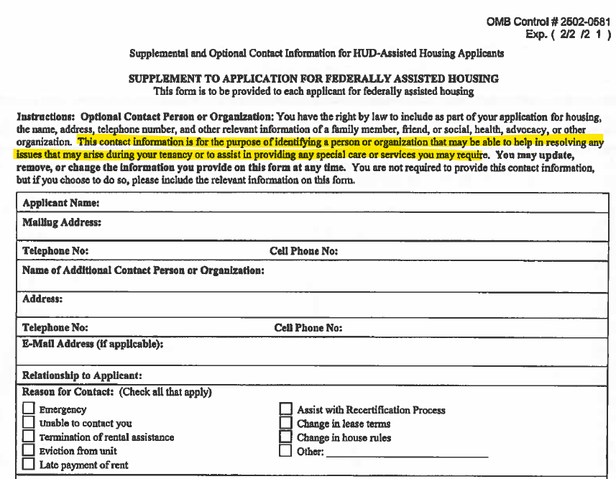
5. Optional Contact Form 92006:

Slide 27
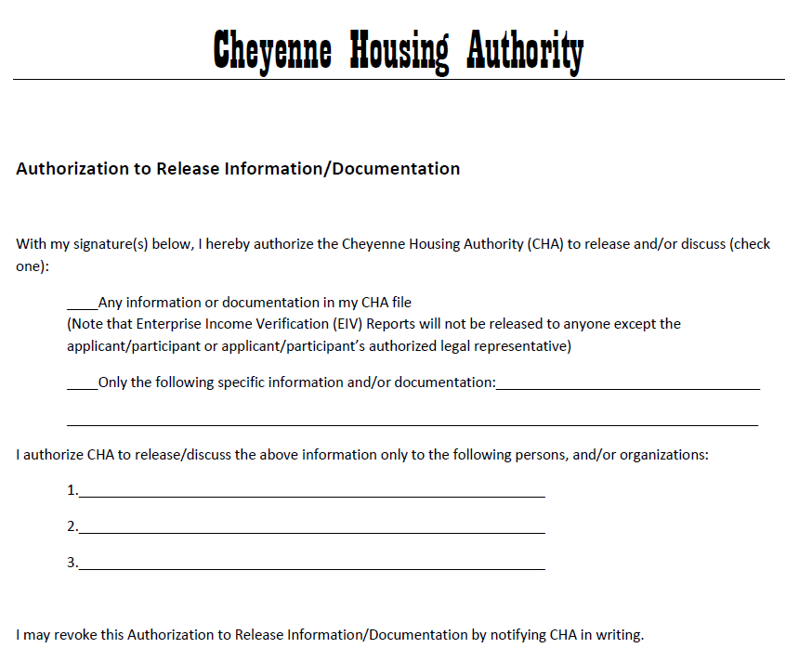
5. CHA’s Authorization for Release of Information (AROI):

Slide 28
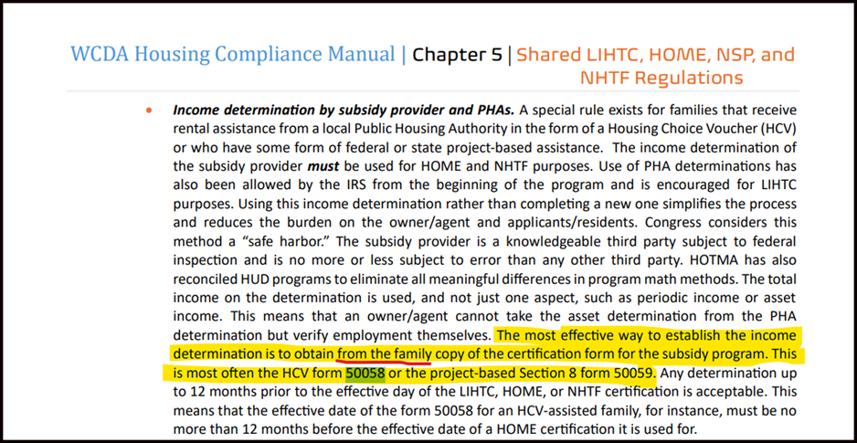
5. Requests for copies of 50058s:

Slide 29
How We Can Help You!
Answer questions
Add you to our Landlord list
Post your flyers on our Bulletin Board
Let us know if you have vacancies!
Landlord Portal has a lot of good information

Slide 30
Meeting Take A-Ways:
Check out the Landlord Portal!
Make sure the lease information matches the RFTA
Monitor Rent Increase Request Due Dates
Ask CHA questions anytime!
We are in this together!

Slide 31
Any Questions?
Cheyenne Housing Authority thanks you for your participation today!

